Slide 1
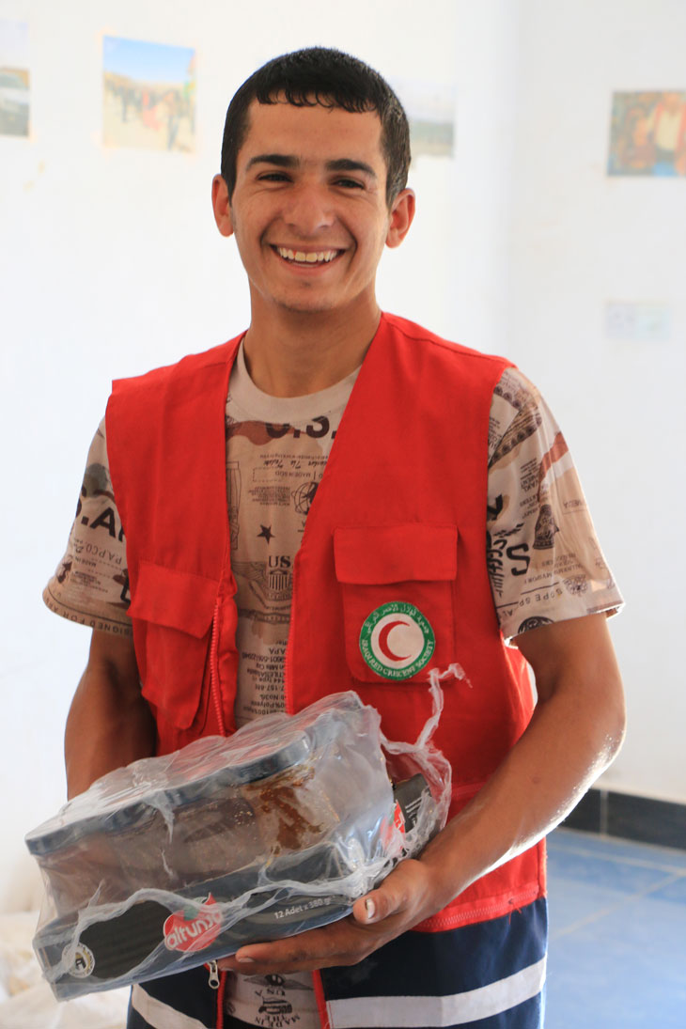
Caring for Volunteers: Basic Training
(NAME OF FACILITATORS)
(DATE)
(VENUE)
[Insert front page photo]

Slide 2
Welcome
The opening activities include:
an icebreaker
an introduction to the training programme
an exercise to agree ground rules for the training.

Slide 3
Training programme
Caring for Volunteers: Basic training
DAY 1
Time | Section
09:00-10:00 | Welcome, introduction to the training programme and ground rules
10:00-10:30 | 1. Understanding psychosocial support
10:30-10:45 | COFFEE/TEA BREAK
10:45-12:00 | 2. Risks, resilience and protective factors
12:00-13:00 | 3. Self-care
13:00-14:00 | LUNCH
14:00-15:00 | 4. Peer support
15:00-15:15 | COFFEE/TEA BREAK
15:15-16:45 | 5. Psychological first aid
16:45-17:00 | Wrap up
DAY 2
09:00-09:15 | Check-in
09:15-10:00 | 6. Setting up psychosocial support systems for volunteers Support strategies at each phase of response
10:00-10:15 | COFFEE/TEA BREAK
10:15-11:00 | Analysing and understanding current support strategies
11:00-12:00 | Developing support strategies
12:00-13:00 | 7. Monitoring and evaluation
13:00-14:00 | LUNCH
14:00-15:15 | 8. Communicating the message
15:15-15:30 | COFFEE/TEA BREAK
15:30-16:15 | 9. Developing an action plan
16:15-16:45 | 10. Evaluation
16:45-17:00 | Wrap up and goodbye

Slide 4
Ground rules
Get into pairs and do the following:
Discuss what helps to establish a good learning environment.
Decide on one thing that you both think is important.
Write it on a post-it note.

Slide 5
The importance of psychosocial support

Slide 6
The importance of psychosocial support
Some of the consequences of not paying attention to the psychosocial well-being of volunteers include:
high levels of absence and volunteer turnover
lack of motivation and poor performance
increased conflicts within the volunteer group
increased ill-health
increased accidents and incident reports.

Slide 7
What is psychosocial support?
Psychosocial support refers to the actions that address both the social and psychological needs of individuals, families and communities.

Slide 8
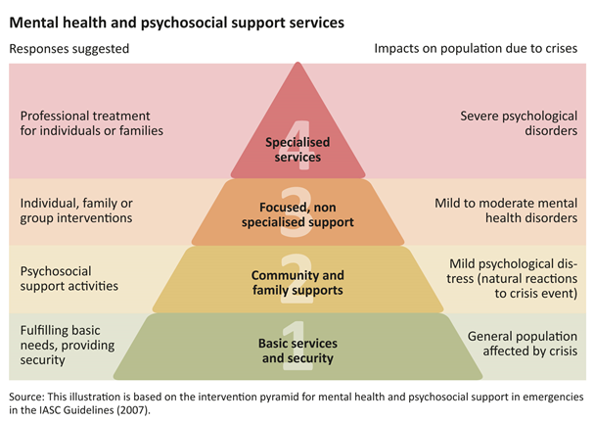
Levels of psychosocial support
Psychosocial support can be given at different levels depending on the needs and resources of the volunteers.

Slide 9
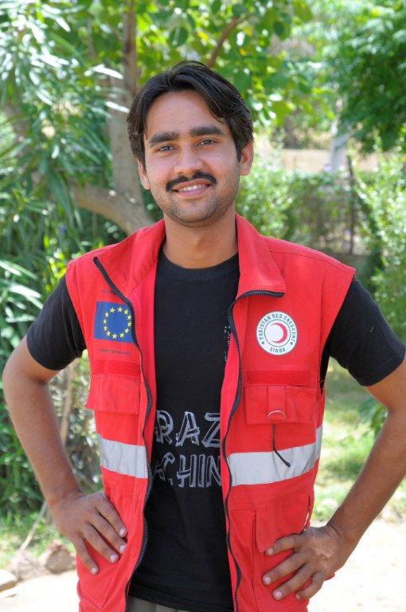
Risks, resilience and protective factors

Slide 10
Risks to volunteer well-being
Spend 5 minutes individually responding to the following question. Write down all the risks that come to mind:
What are the main risks to volunteer well-being?

Slide 11
Risks to volunteer well-being
Personal domain
feeling guilty at the death of someone they were helping
having idealistic/unrealistic expectations of what a volunteer can do to help others
feeling one has to solve all the problems for someone they are helping
feeling guilty about paying attention to one’s own need for rest or support
facing moral and ethical dilemmas.

Slide 12
Risks to volunteer well-being
Interpersonal domain
feeling unsupported by one’s colleagues or supervisors
having difficult dynamics within a team
working with team members who are stressed or burned out.

Slide 13
Risks to volunteer well-being
Working conditions
performing physically difficult, exhausting and sometimes dangerous tasks, or being expected (or expecting themselves) to work long hours in difficult circumstances
becoming increasingly detached from their own family and home life
feeling inadequate to deal with the task, or overwhelmed by the needs of the people they are trying to help
being a witness to traumatic events – or hearing survivors’ stories of trauma and loss.

Slide 14
Risks to volunteer well-being
Organizational issues
having an unclear or non-existent job description or unclear role on the team
being unprepared for facing the frustration and anger of beneficiaries who feel their needs are not being met
lack of information-sharing
being poorly prepared or briefed for the task
lacking boundaries between work and rest
having an atmosphere at the workplace where volunteer well-being is not valued and where their efforts are not being acknowledged or appreciated.

Slide 15
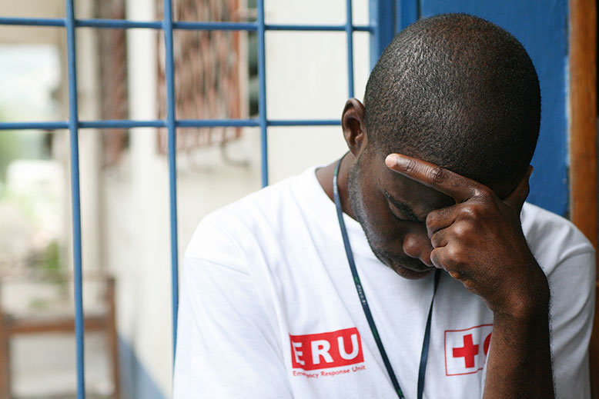
Stress
Stress is a normal reaction to a physical or emotional challenge and occurs when demands are out of balance with resources for coping.
[Insert picture]

Slide 16
Stress
Day to day stress: This represents those challenges in life which keep us alert and on our toes, and without which life for many people becomes dull and ultimately not worth living.
Cumulative stress: This occurs when the sources of stress continue over time and interferes with regular patterns of functioning and daily life.
Critical stress: This represents situations where individuals are unable to meet the demands upon them and suffer physically or psychologically.

Slide 17
Burnout
Burnout is an emotional state due to long-term stress, characterized by chronic emotional exhaustion, depleted energy, impaired enthusiasm and motivation to work, diminished work efficiency, a diminished sense of personal accomplishment, pessimism and cynicism.

Slide 18
Burnout
Burnout is characterized by:
physical symptoms, such as headaches or sleep difficulties
behaviour changes, such as risk-taking or abuse of substances
relational problems, such as temper outbursts or withdrawing from colleagues
becoming less efficient at work or having difficulty concentrating
developing a negative attitude toward the job or organization, or toward beneficiaries themselves
emotional distress, such as continuous feelings of sadness, cynicism and pessimism.

Slide 19
Understanding resilience
Resilience is the ability to react or adapt positively to a difficult and challenging event or experience.
It is often described as the ability to ‘bounce back’ after something difficult has happened, or to get through difficult experiences in a positive way.

Slide 20
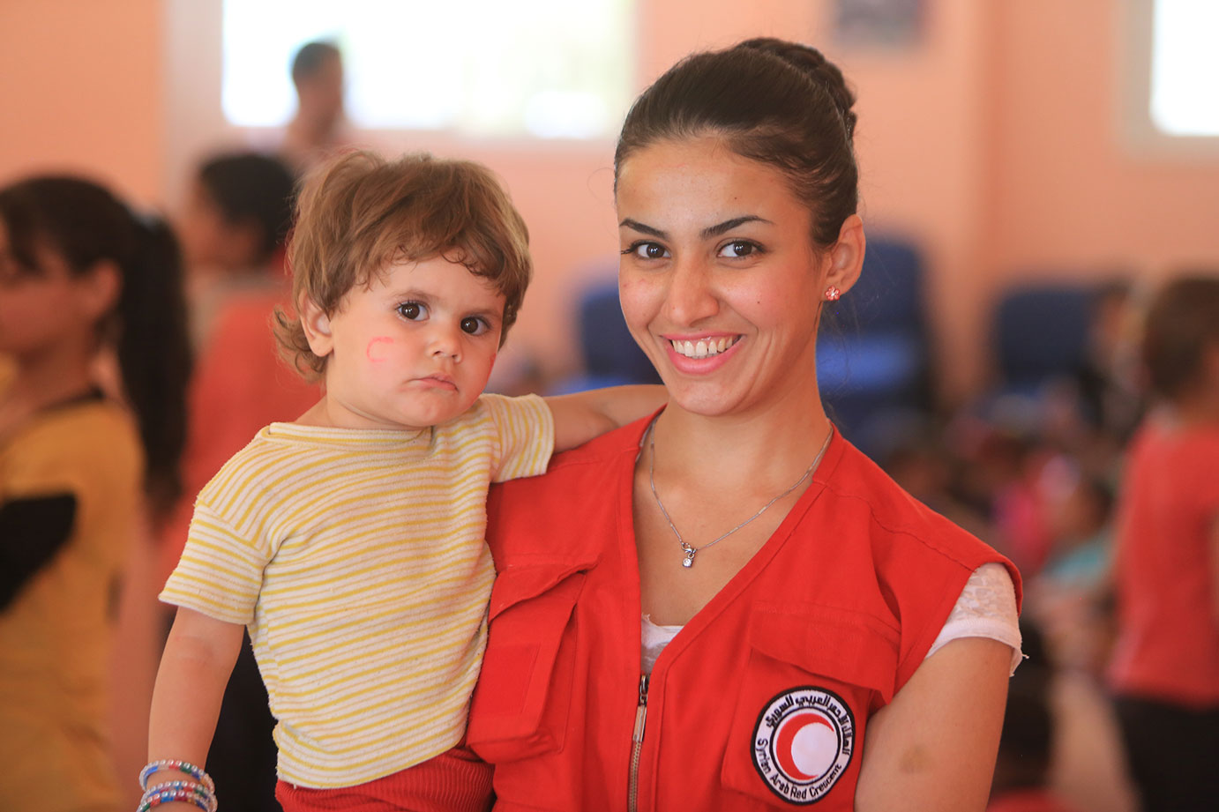
Protective factors
Protective factors are the interacting social, psychological and biological factors that strengthen a person’s resilience.
[Insert picture]

Slide 21
Protective factors
Read the handout ‘Volunteering in Norway after July 2011’ and discuss in groups:
What factors might have protected the volunteers from experiencing stress?
What other protective factors could also foster resilience among volunteers?

Slide 22
Responsibilities
Who is responsible for volunteer well-being?

Slide 23
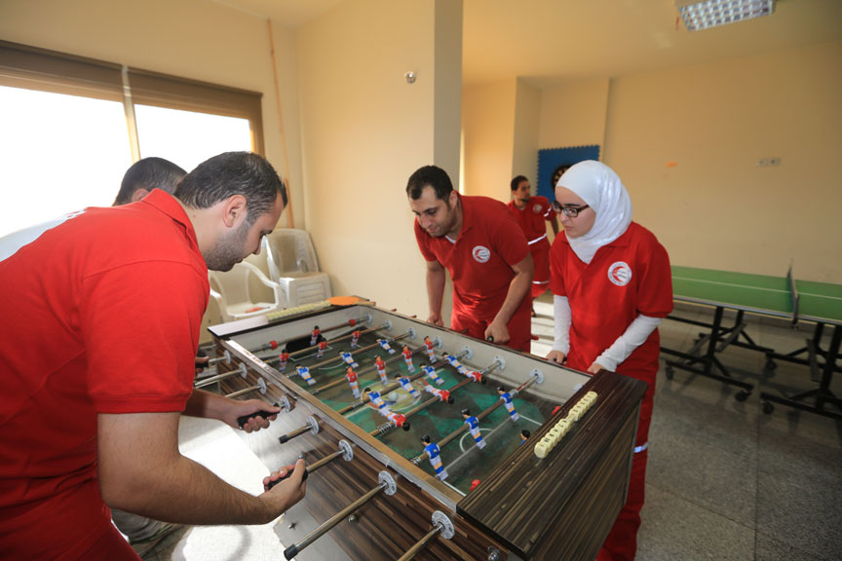
Self-care

Slide 24
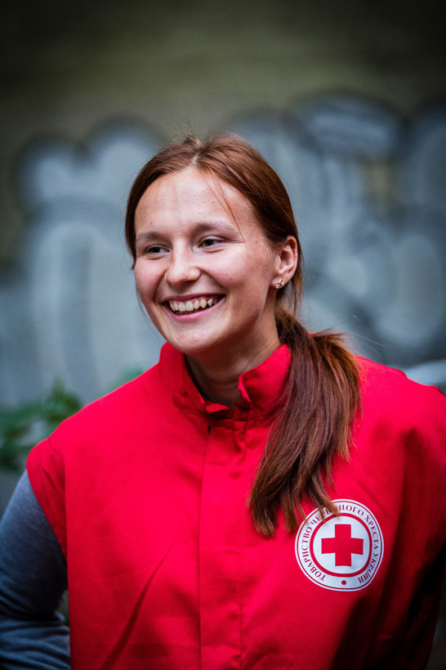
Resources for stress management
What do you do to keep yourself healthy on a daily basis?
What resources do you call upon, especially when times are tough?

Slide 25
Self-care reminders for volunteers
If you feel overwhelmed by the situation or your duties, focus for a while on simple and routine tasks. Let peers and supervisors know how you feel and be patient with yourself.
Talking with someone about your thoughts and feelings may help you to process and come to peace with any unpleasant experiences.
Know that some reactions are normal and unavoidable when working in difficult circumstances.
Get enough rest and sleep.
Limit your intake of substances as alcohol and tobacco.

Slide 26
Self-care reminders for volunteers
If you have sleep difficulties or feel anxious, avoid caffeine especially before bedtime.
Exercise to regulate or relieve tension.
Eat healthy foods and keep regular meal times.
Keep in touch with loved ones.
Talk about your experiences and feelings (even those that seem frightening or strange) with colleagues or a trusted person.
Don’t be ashamed or afraid to seek help if you are feeling stressed, sad or unable to handle your duties. Many other people may be experiencing the same feelings.

Slide 27
Self-care reminders for volunteers
Listen to what others say about how the event has affected them and how they cope. They may share useful insights.
Express your feelings through creative activities, like drawing, painting, writing or playing music.
Play and take time for fun.
Consciously try to relax by doing things you enjoy, such as meditation or yoga.

Slide 28
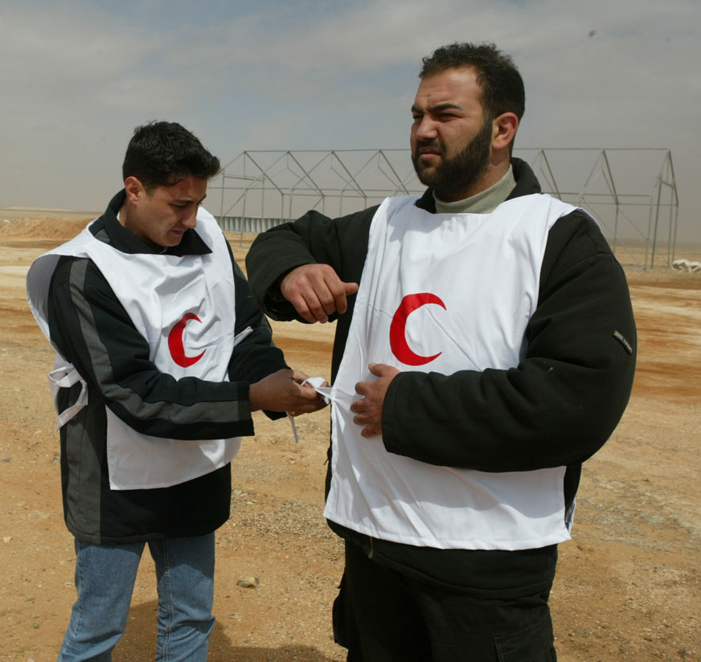
Peer support

Slide 29
Peer support
Peer support:
means offering assistance to someone who is in the same position as the supporter
is a useful strategy for coping and managing stress
makes good use of the resources within the organization and among volunteers.
is an active process and requires peers to be engaged in supporting each other and creating the time and space to talk together about reactions, feelings and coping mechanisms.

Slide 30
Advantages of peer support
It can often be implemented quickly, once systems are put in place.
Often peer support prevents volunteers who are under stress from developing other problems.
Sharing difficulties with peers reduces misunderstandings or misreading of behaviour, etc.
Volunteers are able to learn ways of coping from each other, and thereby further develop their own coping skills.
Meeting in groups can decrease any fear or stigma about expressing emotions and seeking help.

Slide 31
Setting up peer support systems
There are various ways of providing peer support, including:
buddy systems
group peer support meetings
trained peer supporters.

Slide 32
Setting up peer support systems
Divide into three groups:
Group 1: List five key elements in peer support.
Group 2: List five things to consider when arranging peer support meetings.
Group 3: List five topics that peer supporters training.

Slide 33
Tips for peer supporters
Be available
Manage the situation and locate resources
Provide information
Assist the person you are supporting to establish personal control
Give encouragement
Maintain confidentiality
Provide follow-up.

Slide 34
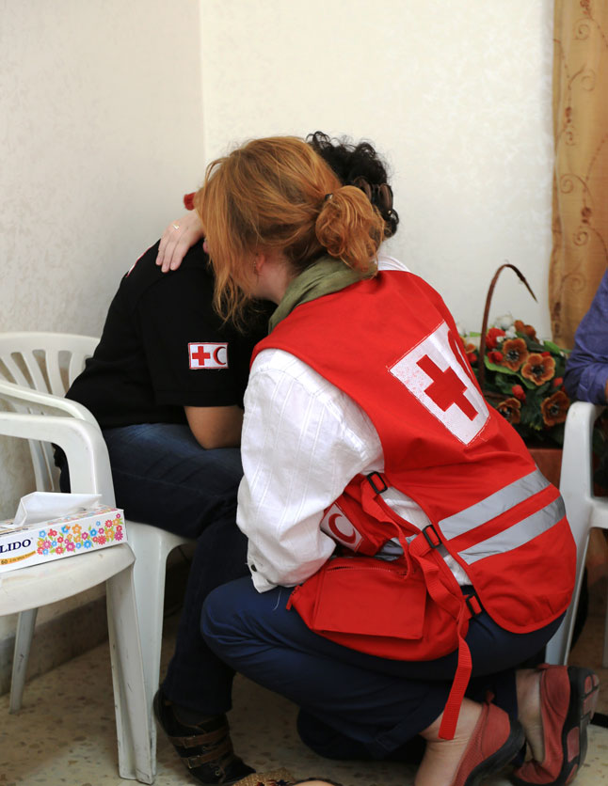
Psychological first aid for volunteers

Slide 35
Psychological first aid for volunteers
Psychological first aid (PFA) is caring support, offered to volunteers who have experienced a very distressing event or situation. It involves showing them warmth and empathy and listening to them. It also involves making the surroundings safe for them and helping them to deal with practical needs and problems.

Slide 36
Supportive communication
Supportive communication:
includes showing empathy, care and concern; listening attentively and without judgment; and maintaining confidentiality.
is a skill that requires special awareness of one’s words and body language, as well as one’s attitude and attention to the person in distress.

Slide 37
The four key elements of PFA
Stay close
Listen attentively
Accept feelings
Provide general care and practical help.

Slide 38
PFA role play
Work in pairs and decide on which role to take:
PFA helper
help-seeker
Keep in mind the basic elements of PFA.

Slide 39
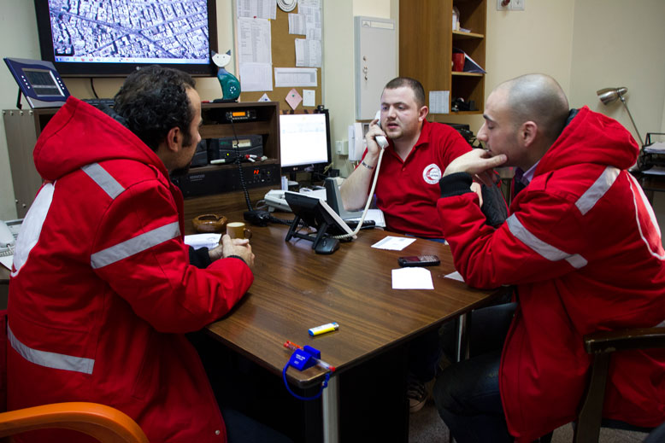
The referral process

Slide 40
When and how to refer
Distressed volunteers will probably need to be referred to a professional for more specialised care if:
they are so severely distressed that they are unable to function in their daily lives
they are in risk of harming themselves
they are a danger to others.

Slide 41
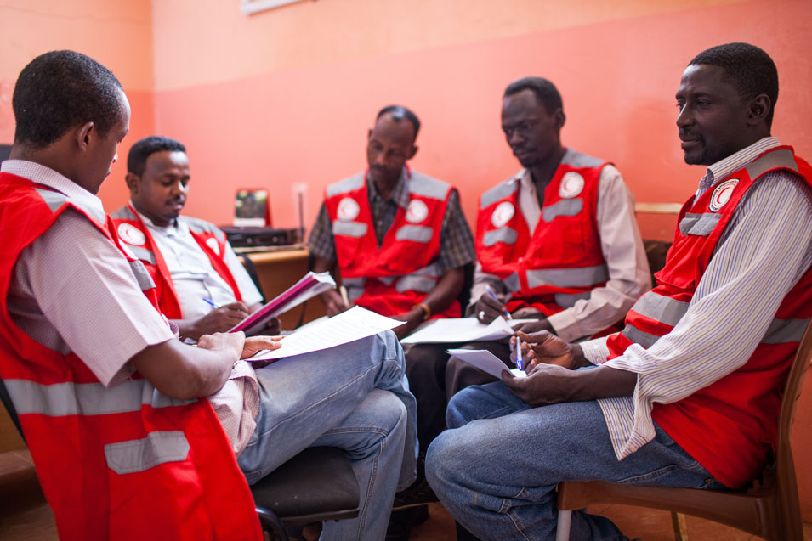
Setting up psychosocial support systems for volunteers

Slide 42
Support activities at each phase of a response
Before the actual response, it is important to prepare the volunteers for the task at hand.
During the activity, it is important to provide the volunteers with on-going support.
After the response, it is time for recovery, reflection and improving future responses.

Slide 43
Support activities at each phase of a response
Group 1: Before
How can managers promote the psychosocial well-being of volunteers before a crisis occurs, or before volunteers are sent to help?
Group 2: During
How can managers promote the psychosocial well-being of volunteers during the active response to a single event or in a prolonged crisis?
Group 3: After
How can managers promote the psychosocial well-being of volunteers after the crisis is over, or when the volunteers end their work?

Slide 44
Managers and volunteer resilience (1)
Managers can:
Ensure reasonable working hours and conditions for volunteers
Prepare job descriptions or make clear what is expected
Prepare and train volunteers for their task in the field
Check in with volunteers to see how they are coping during the emergency response
Have regular team meetings during the emergency to check in with everyone and offer support.

Slide 45
Managers and volunteer resilience (2)
Encourage volunteer work to be carried out in pairs
Set up peer support or buddy systems
Offer information about stress and its impacts
Encourage good coping strategies
Support volunteers who have experienced especially difficult events
Show appreciation and let volunteers know they are valued members of the team.

Slide 46
Analysing and understanding current support systems
Read the handout ‘Basic and additional strategies.’
Tick off the procedures and strategies you currently have in place in your National Society.

Slide 47
Developing support systems
The following three questions are good prompts in developing a strategy for psychosocial support of volunteers:
What – what kind of support can we provide?
Who – who provides the support? Who is eligible to receive support?
When – how often and under what circumstances should support be provided?

Slide 48
Developing support strategies
Spend 40 minutes in your groups, answering the questions in handout 4 ‘Developing support strategies.’

Slide 49
What kind of support?
Whatever activities your National Societies decide upon, the important thing is to be sure to include all the points of the response cycle - before, during and after – in order to be truly effective.

Slide 50
Who will provide the support?
Supervisors and team leaders play an important role in support.
Senior managers provide backup.
Supervisors need basic training, both in supporting volunteers and in caring for their own psychological well-being.
Volunteers themselves are a resource in the psychosocial support system.
Peer support mechanisms can be put in place to provide a network of support.

Slide 51
Who will receive psychosocial support?
All volunteers must be able to access adequate and systematic psychological support.
Not all volunteers will need the same level of support, but they should all be able to access appropriate support when they need it.
As you consider your resources, try to match psychosocial support strategies with the needs of your volunteers and the context in which they work.

Slide 52
When will support be provided?
Consider the feasibility and relative advantages of providing support before an emergency happens.
Other types of support involve routine individual and team support measures during and after the emergency.
Making some psychosocial support measures mandatory, rather than ‘on-demand’ will make it easier for volunteers to seek support.
Not everyone will want or need professional support during or after working in an emergency.

Slide 53
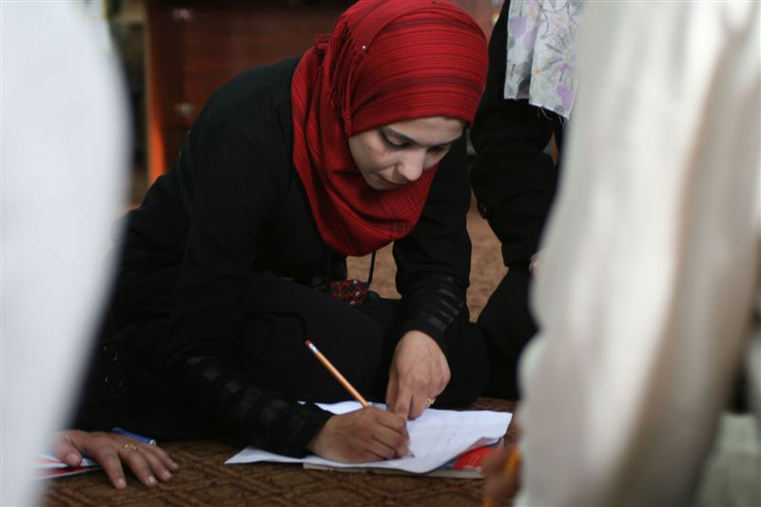
Monitoring and evaluation of volunteer support

Slide 54
What to monitor and evaluate?
What types of volunteer support are currently in place?
How well are the support systems working?
What methods can be used to collect this information?

Slide 55
Monitoring and evaluating
Work in the same groups as before and develop a strategy for monitoring and evaluation. Answer the following questions:
How can you monitor and evaluate the psychosocial support system you developed in the last activity?
What could work as indicators of a change?
Spend 20 minutes on this task and be prepared to present your strategy in plenary.

Slide 56
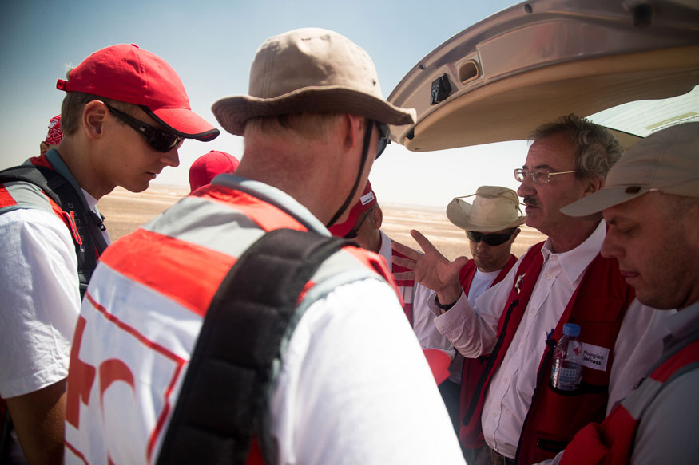
Communicating the message

Slide 57
Communicating the message
When providing information to volunteers:
Consider the language(s) your volunteers speak, their level of education, their culture and their customs.
Try to keep messages simple, and give clear instructions for accessing support, including telephone numbers of referral networks or other contact details.
Have information available in various formats, such as posters, leaflets or other pocket information.
Prepare information in advance of an emergency, where possible.
Consider when the information should be given to volunteers.

Slide 58
Communicating the message
Prepare a five-minute presentation suitable for volunteers on the topic allocated to your group:
Group 1: Key messages about psychosocial support
Group 2: Psychosocial support for volunteers
Group 3: Information for volunteers

Slide 59
Developing an action plan
Developing an action plan has the following advantages:
It lends credibility to your National Society.
You keep track of important details.
You save time, energy and resources.
You understand what is possible and not possible with your resources.
You increase the chance of reaching your goals.

Slide 60
Developing an action plan
What are your goals for the next six months?
What actions do you need to take to achieve your goals?
What is the deadline for each action?
Who is responsible for following up on each action?

Slide 61
Developing an action plan
Do you need any further training to achieve your goals?
Where can you get support if you need additional support to achieve your goals?
How will you communicate with each other about the status of your specific actions? (e.g., monthly meetings, phone meetings, e-mail, web-based groups, etc.)

Slide 62
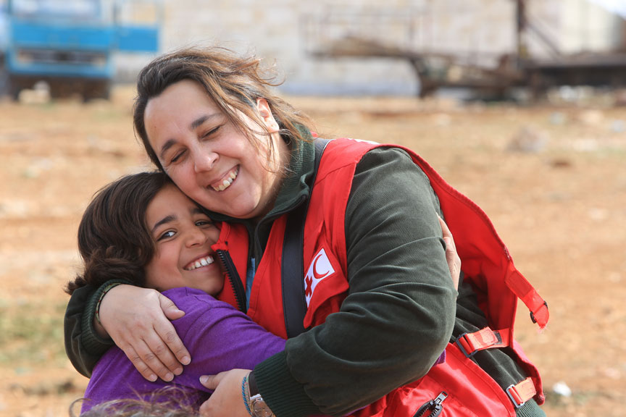
Wrap up and goodbye

