Slide 1
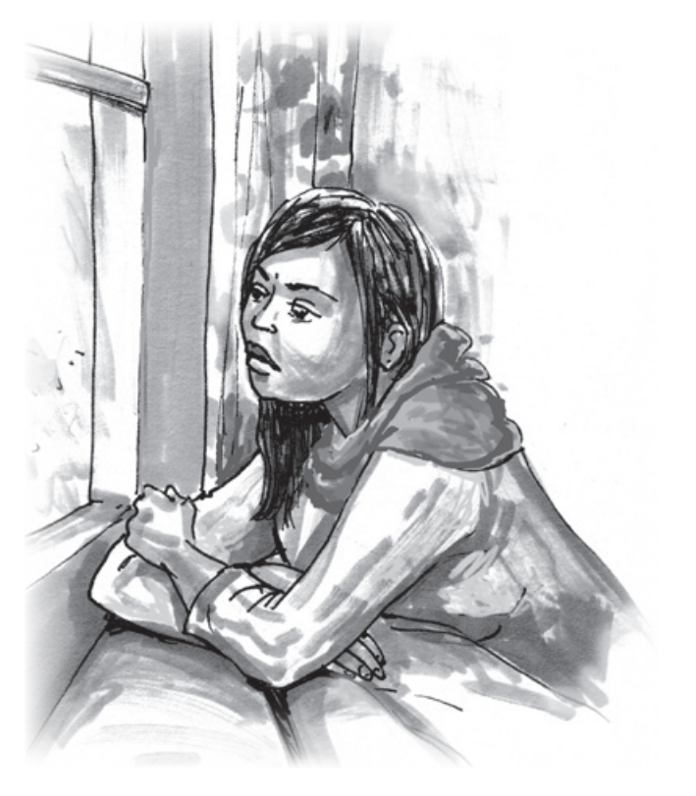
PSYCHOLOGICAL FIRST AID
FOR VACCINE HESITANCY
IN THE COVID-19 OUTBREAK RESPONSE
Notes:
[Present yourself, your organization, and your role. See the example below. Adapt to details of the facilitator.]
Hi, my name is XXXXXX. I am a MHPSS Officer and trainer for the local National Society.
Welcome to this short training module on PFA for vaccine hesitancy for COVID-19. This is an additional module to the basic training on psychological first aid in the COVID-19 outbreak response for staff and volunteers in Red Cross and Red Crescent National Societies. It is developed for people who have taken part in the basic training and have foundational knowledge of PFA and how it can be applied in the response to the COVID-19 crisis.
[Provide technical information about how the training will function. See the On-line facilitation in Mental Health and Psychosocial Support for more on this: https://pscentre.org/on-line-facilitation-in-mental-health-and-psychosocial-support/
For example, if using ZOOM here are some things to explain:
Breakout rooms
Mute when not speaking
Raise your hand electronically if you want to speak
Write short comments in the chat box.
A good practise with online trainings is to manage feedback and pick on random people to contribute. See below for an example of what you can say:
“During the training when we have feedback sessions, I will pick you randomly and ask for your input, to make sure everyone gets a chance to contribute. If you have something very important you want to add after your colleagues have shared, raise your hand and we will see if we have time for more input.’
I would now like to give each of you about 30 seconds to introduce yourselves [Choose an appropriate duration for each participant depending on how many people are taking part. Don’t spend more than 5 minutes on this.] Please say your name, where you work and one myth or negative thing you have heard about the COVID vaccine. Its doesn’t have to be something you agree with, just something you have heard or seen.]

Slide 2
PSYCHOLOGICAL FIRST AID FOR VACCINE HESITANCY
Learn or deepen PFA skills to supportively respond to people who are vaccine hesitant to the COVID-19 vaccine.
AIM OF TRAINING
Build or deepen skills in demonstrating empathy and understanding, especially with others who may have different viewpoints or values.
Notes:
The aim of this training module is for participants to learn or deepen psychological first aid skills to supportively respond to people who are vaccine hesitant to the COVID-19 vaccine.
The module is also helpful when supporting someone who holds a different viewpoint or different values from the PFA provider, as the training also builds or deepens skills in demonstrating empathy and understanding.
The training is not about deceiving someone into having a COVID-19 vaccine. It’s about supporting people to feel calm, informed, supported and in control of their own decisions about the vaccine.

Slide 3
PSYCHOLOGICAL FIRST AID FOR VACCINE HESITANCY
Factors that influence peoples’ reactions to vaccines
TRAINING CONTENT
PFA for vaccine hesitancy: Look, Listen and Link
Promoting safety, calming, self-efficacy and connectedness
Notes:
The training module will cover:
The factors that influence people’s reactions to vaccines.
We will discuss the latest model refined by experts in 2020 which describes four different behavioral and social drivers of these reactions
The three PFA principles of Look, Listen and Link as they directly relate to supporting people who are vaccine hesitant
And discussions on ways to promote safety, calming, self-efficacy, and connectedness to help people who are vaccine hesitant to feel calm, supported and in control of their own decisions.

Slide 4
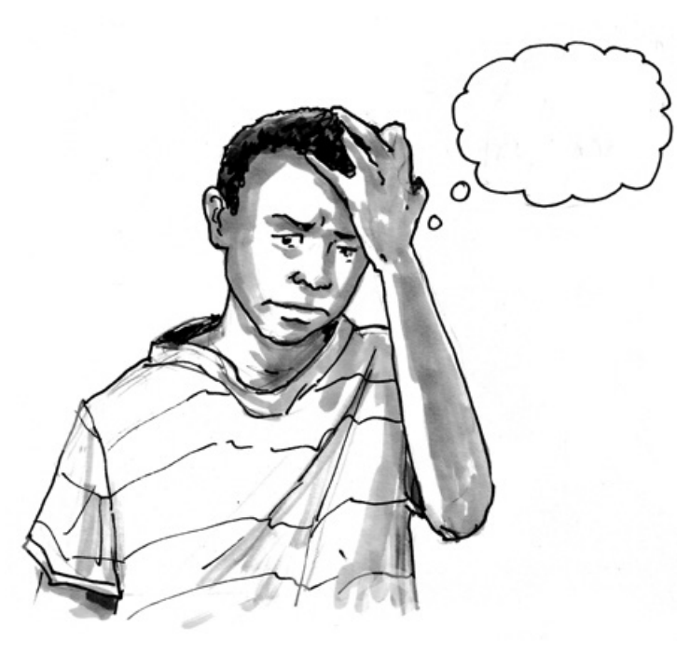
PSYCHOLOGICAL FIRST AID FOR VACCINE HESITANCY
WHAT IS VACCINE HESITANCY?
WHO defines vaccine hesitancy as “A motivational state of being conflicted about, or opposed to, getting vaccinated.”
Vaccine hesitancy can result in “a delay in acceptance or refusal of vaccines despite availability of vaccination services.”
Notes:
WHO (the World Health Organization) established the global expert group called ‘Measuring Behavioural and Social Drivers of Vaccination’ (BeSD). The members are representatives from global agencies and experts from multiple geographical regions, covering a range of social and behavioural science disciplines across high-, middle-, and low-income settings.
They define vaccine hesitancy for any vaccine and not just for COVID-19 as “A motivational state of being conflicted about, or opposed to, getting vaccinated.” The group also notes that vaccine hesitancy can result in “a delay in acceptance or refusal of vaccines despite availability of vaccination services.”
Take a moment to reflect on this definition. How does this definition resonate with you? Do you agree, disagree, or have questions? [If using a camera ask for a thumbs up or thumbs down or a flat hand shaking response, if no camera ask to write in the chat ‘agree’ or ‘disagree’ ‘not sure’. Then call specifically on 2-3 people only to comment (ensuring one positive and one negative respondent) and ask them for their reflections on the definition.]
[The below text is not specifically part of the training, however other terms as defined by the BeSD group are below in case the facilitator is asked about these terms which are closely linked to vaccine hesitancy.
Confidence. The belief that vaccines work, are safe, and are part of a trustworthy medical system.
Demand. Desire for vaccination - the motivations of individuals and communities to seek, support, and/or advocate for vaccines and immunization services. Demand for vaccines and vaccination is a complex concept that is not external to supply systems but rather encompasses the interaction between human behaviours and system structure and dynamics.
Acceptance. Agreeing to receive a vaccine.
Un-vaccinated. An individual has received none of the recommended vaccines for age.
Under-vaccinated. An individual has received some, but not all recommended vaccines by schedule milestone.]

Slide 5
PSYCHOLOGICAL FIRST AID FOR VACCINE HESITANCY
WHAT ARE SOME FEARS SPECIFICALLY ABOUT THE COVID-19 VACCINE?
Activity 1
List some of the fears around the COVID-19 vaccine.
Notes:
Let’s start by looking at some common fears around the COVID-19 vaccine.
Share in the chat [Or use a program such as mentimeter.com to make an interactive word cloud or list] some of the fears that you have heard about regarding the COVID-19 vaccine. You don’t have to agree with them, just list what you have heard or are aware of.

Slide 6
PSYCHOLOGICAL FIRST AID FOR VACCINE HESITANCY
COMMON FEARS ABOUT THE COVID-19 VACCINE
The speed of vaccine development makes them unsafe
Some vaccines use new technology, making them unsafe
They are not well tested on minority groups
The vaccine side effects are really bad
It is unknown if the vaccines will protect against all variants
Officials promoting the vaccines can not be trusted
Notes:
Here are some of the fears that I have heard about the COVID-19 vaccine.
[Read out or show the slide with some common fears. Adjust the PowerPoint to reflect fears the presenter has heard about. Comment on how the fears on this PowerPoint link or overlap - or don’t! - to the fears that the training participants produced in the previous exercise.]
It is important to note that while some fears may be shared, and some may be culturally specific, other fears will be unique to each individual. This is why we should take the time to listen closely and actively so we can better understand people´s unique fears or concerns. It is only then that are we able to respond respectfully and provide calming and support to people who are vaccine hesitant.

Slide 7
PSYCHOLOGICAL FIRST AID FOR VACCINE HESITANCY
PRACTICAL ISSUES
Vaccine availability
Convenience, costs
Service quality and satisfaction
Requirements, incentives
Intervention fatigue
WHAT PEOPLE THINK AND FEEL
Perceived risk, worry
Confidence, trust
Safety concerns
VACCINATION
Schedule appt
Consent
Accept vaccine
Delay
Refusal
MOTIVATION
Readiness
Willingness
Intention
Hesitancy
SOCIAL PROCESSES
Provider recommendation
Social norms
Gender norms and equity
Sharing info, rumors
Source: The BeSD expert working group. Based on: Brewer NT, Chapman GB, Rothman AJ, Leask J, and Kempe A (2017). Increasing vaccination: Putting psychosocial science into action. Psychological Science for the Public Interest. 18(3): 149-207
Notes:
Fears are however only one reason why people can be vaccine hesitant.
In November 2018, the BeSD Group (Measuring Behavioral and Social Drivers of Vaccination), revised previous models and literature and developed the conceptual model shown on the slide. It describes the behavioral and social reasons behind vaccine uptake.
The model is based on the idea that people are rational actors and make decisions by considering how likely and how bad (or good) the consequences would be of getting vaccinated. This forms their motivation. Practical factors also influence people's final decision to accept, delay or refuse vaccination.
Now you have seen a quick overview of the model, let’s break the model down and look at each part in more detail.

Slide 8
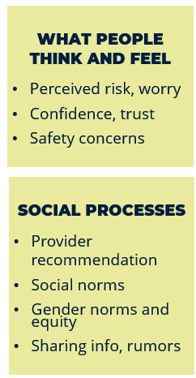
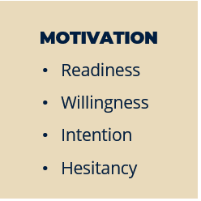
PSYCHOLOGICAL FIRST AID FOR VACCINE HESITANCY
Notes:
The left-hand side of the model shows two key areas that influence motivation.
As we already noted, the model is based on the idea that people are rationale actors and therefore they are ‘motivated’ to choose the action – to get vaccinated or not - that they feel would lead to the best future for themselves and those close to them.
What people think and feel about vaccines
People make decisions about vaccines based on their perceptions of risks about the illness and risks about the vaccine. Generally, if someone thinks the likelihood of getting an illnesses is low, then they are less likely to be motivated to get vaccinated. Likewise, if someone assesses that getting COVID (or another illness) is more likely to result in very mild, short-term symptoms, rather than more serious symptoms such as hospitalisation, death, or long-term negative symptoms, then they are less likely to be motivated to get vaccinated.
People also consider the risks associated with the vaccine itself. Such risks may include for example, the risk of negative vaccine side effects, not being able to work or interact freely in society or social exclusion.
So too, the worries someone may have about the virus; someone's confidence or trust in the vaccine or health authorities; and any other safety concerns about the virus or the vaccine that someone may have influence motivation to get vaccinated.
Social processes and pressures
Such as provider recommendations, social norms, gender norms and equity, the different ways information is shared (for example either online or in person, or from a doctor, government or by word of mouth) and rumours can also influence people's motivation.
Individual motivators or hesitancy
After weighing up the pros and cons of getting vaccinated, a certain level of readiness, willingness, intention, or hesitancy towards getting vaccinated is established for each individual.
As a PFA provider, its important to remember that while the model is based on the idea of a rationale actor, people may not be consciously aware of all the factors which are influencing their motivation to get vaccinated.

Slide 9
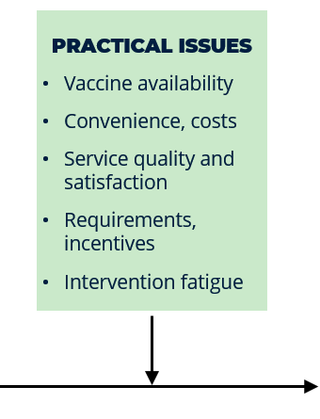
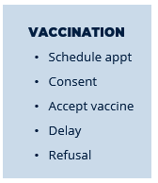
PSYCHOLOGICAL FIRST AID FOR VACCINE HESITANCY
Notes:
As already mentioned, vaccination is a complex process that is about more than just individual motivation
4. Practical factors in seeking or receiving a vaccine
such as vaccine availability; the convenience of getting vaccinated; any costs associated with the vaccine for example the cost of the actual vaccination, costs incurred through time off work, transport costs to the vaccination venue or other costs; service quality and satisfaction; meeting vaccination requirements such as age, health, etc; any incentives - either social or financial - that might be offered for getting vaccinated (or not vaccinated); and other factors such as intervention fatigue, will also influence the final outcome of whether someone accepts, delays or refuses vaccination.
In summary, the behavioural research identities three categories of drivers of vaccine uptake which are always present and overlap and interact in different ways depending on the context. These are: 1) social influences including what people think and feel; 2) individual motivation; and 3) an enabling environment. The interaction of the three drivers is why information about vaccines on its own is not sufficient to promote strong vaccine uptake.

Slide 10
PSYCHOLOGICAL FIRST AID FOR VACCINE HESITANCY
Activity 1
Discuss in groups one factor of the model:
What people think and feel
Social processes
Motivation
Practical issues
How may this factor lead to someone being vaccine hesitant?
Notes:
In preparing to provide PFA to people who are vaccine hesitant, we can use this model to help us better understand some of the processes that may lead someone to be vaccine hesitant or to delay or refuse vaccination.
I am going to assign you to a group in a few moments and ask you to discuss one of the elements within one of the factors in the model. You will have 10 minutes together to discuss how the aspects within this factor may lead someone to be vaccine hesitant.
Before we go into groups, let me mention the definition of vaccine hesitancy again:
A motivational state of being conflicted about, or opposed to, getting vaccinated.
Vaccine hesitancy can result in “a delay in acceptance or refusal of vaccines despite availability of vaccination services.
[If possible, divide participants into four small groups or pairs to discuss. If using Zoom, use breakout rooms. Give participants 10 minutes to complete this task. Pick on random groups to give feedback and ask to keep the responses concise, to try and get maximum participation from everyone.]

Slide 11
PSYCHOLOGICAL FIRST AID FOR VACCINE HESITANCY
GENERAL PFA DO’S AND DONTS OF SUPPORTING PEOPLE WHO ARE VACCINE HESITANT
Activity 3
Answer “Do” if this is something we should do, or “Don’t” if we should avoid this when supporting people who are vaccine hesitant
Notes:
Before we go in-depth to each of the three principles of PFA - Look, Listen and Link - I am going to read out some statements which are general PFA “Do’s” and “Don’t’s” of supporting people who are vaccine hesitant. Please answer the questions and we will briefly discuss why it is a general “do” or “don’t”.
[Instructions to run activity
Ask participants to make two signs quickly on separate pieces of A4 /A5 sized paper. On one piece of the paper write “Do” in bold text and on the other paper write “Don’t”. Alternatively, it could be different coloured pieces of paper.
Ask them to hold up the correct answer to the camera each time a statement is read out and lead a small discussion on each of the key principles. Some suggestions for the small discussion are provided in the notes section of the next slide – adapt as necessary.
Or, if using Zoom or another platform, you may prefer to run a poll or a quiz and then lead the small discussion on each key principle.
Read the statements on the next slide in random order of Do’s and Don'ts for vaccine hesitancy.
Do NOT show the next slide while you are doing the Do’s and Don’ts activity, as it gives the answers away. Show the Do’s and Dont’s slide / the next slide after the activty is complete.]

Slide 12
PSYCHOLOGICAL FIRST AID FOR VACCINE HESITANCY
DO | DON’T
Find common ground | Emphasise differences in views
Take time to understand what people are thinking and why | Assume you know why they are vaccine hesitant
Be open, polite and respectful | Attack peoples character or views
Validate genuine concerns | Dismiss genuine concerns
Identify misinformation without judgement and supply useful information | Identify wrong conclusions in a judgemental or condescending way
Focus on the facts | Focus on the myth
Allow people an ‘out’ that doesn’t cause embarrassment | Set people up for embarrassment if they change their mind
Notes:
[Provide brief feedback after each statement about why it is a ‘Do’ or a ´Don’t´. Use or adapt the text below. ]
Find common ground / Emphasise differences in views
Anyone can feel COVID-19 vaccine hesitant. Its normal and natural to take a cautious approach to novel things.
When we find common ground with others they are more open to hear our perspective
Take time to understand what others are thinking and why / Assume you know why they are vaccine hesitant
People are complicated and there are many reasons why they may be vaccine hesitant. We already discussed some when going over in the BeSD model.
Only once you know and understand the persons reasons, can you work towards providing helpful support and information.
Resistance to the COVID-19 vaccine is an inevitable part of the process of discussing vaccines with someone who is vaccine hesitant. Dont be disheartened. Give it time. Be patient.
Being respectful, honest, open and polite will allow the person to more fully engage with what you have to say. It will also help them feel more calm and able to take in new information and make their own decision.
Be open, polite and respectful / attack someone’s character or views
People pull back and are less likely to listen or engage in a conversation when they feel attacked
Focus on the facts / focus on the myth
People tend to remember what is focused on. Focusing on the myth is likely to make the myth even stronger. We should not avoid talking about the myth, but it should not be the focus of the conversation. The facts should be the focus. Any mention of the myth should be proceeded by an explicit warning that the upcoming information is a myth. For example “A common myth is that the vaccines were developed too quickly to be safe. However the correct information is that the vaccines are safe. They were are be to developed safely in a short amount of time as… This means that the vaccines are safe.”
Validate genuine concerns / Dismiss genuine concerns
Part of being open, polite and respectful is validating genuine concerns. People feel more at ease when genuine concerns are treated respectfully and they are more open to listening to other information that you may present.
Identify misinformation without judgement and supply useful information / Identify wrong conclusions in a judgmental or condensing way
Communicate useful factual and logical information politely and respectfully. It is helpful to point out ‘errors’, and this should be done politely.
Refutation should include an alternative explanation that accounts for the important qualities in the original myth or misinformation.
‘Useful information’ is information someone is missing, information that provides perspective, identification of errors (without judgement), provision of an alternative explanation of information that is an ‘error’, and providing reputable sources of information
Allow people an ‘out’ that doesn’t cause embarrassment / Set people up for embarrassment if they change their mind
Some people have invested a lot in their vaccine hesitant views (time researching and/or strained relationships with judgemental non-vaccine hesitant people). Giving someone a little bit of useful information and a respectful space to question their beliefs and change their mind promotes a more open stance to new information and a higher likelihood of change of perspective.

Slide 13
PSYCHOLOGICAL FIRST AID FOR VACCINE HESITANCY
ACTION PRINCIPLES OF PFA
LOOK
LISTEN
LINK
Notes:
Supporting people who are vaccine hesitant involves the same three action principles that underpin all PFA approaches: Look, Listen and Link. There are however some aspects that we need to pay more attention to when working with people who are vaccine hesitant.
We are now going to go over each of the three action principles one by one as they specifically relate to supporting people who are vaccine hesitant.

Slide 14
PSYCHOLOGICAL FIRST AID FOR VACCINE HESITANCY
LOOK FOR
Information on what has happened and is happening
Safety, protection and security risks
Physical injuries
Immediate basic and practical needs
Emotional reactions
Notes:
[This slide can be shown in two parts. At first, ONLY show the heading “Look for”. Then ask the questions to the participants. After they have given their answers, you can show the text of the slide.]
The actions for LOOK when providing PFA to people who are vaccine hesitant are similar to the Look actions under other circumstances.
Please write in the chat what we should look out for during this action principle when offering PFA.
[Recap some of the answers from the chat while revealing the text of the slide on what to Look for.] On the slide are some things that I have thought about that we should look out for when providing PFA.

Slide 15
PSYCHOLOGICAL FIRST AID FOR VACCINE HESITANCY
ALSO LOOK FOR
Your own biases or views
Know your own limits as a helper
Strong reactions from vaccine hesitant people
Look for (and be prepared to respond helpfully and respectfully to) vaccine hesitancy myths or concerns
Notes:
Three additional factors to also LOOK for when working with people who are vaccine hesitant are:
Focus closely on and manage your own biases or views as these have the potential to interfere with your ability to provide supportive PFA.
Be prepared for possible strong client reactions. Some people have invested a lot or may have been met with a lot of judgement from others about their vaccine hesitant views. They may be primed to react strongly in conversations about vaccines and vaccine hesitancy.
Look for (and prepare yourself in advance to be able to respond helpfully and respectfully to) vaccine hesitancy myths or concerns. Such preparation includes knowing how to promote a sense of safety and being prepared to provide ‘useful’ information. Both of these factors we will look at in more detail on later.

Slide 16
PSYCHOLOGICAL FIRST AID FOR VACCINE HESITANCY
LOOK AT YOURSELF
Activity 4
Write down your own personal views and feelings towards people who are COVID-19 vaccine hesitant.
Notes:
First, let’s look at ourselves. It is important to look at yourself and your own views or biases. It is possible that you have personal views or feelings on this topic which could interfere with your ability to provide non-judgemental, helpful support.
Take a few minutes to write down your own personal views and feelings towards people who don’t take the COVID-19 vaccine. Some may be positive and others negative. In a few minutes we will discuss in a non-judgemental way the negative views so please make sure you write those down also. [Allow 2-3 minutes for this, then ask participants to share with the group their feelings (both positive and negative) for the purpose of normalising negative feelings. Depending on the culture, it may be appropriate to do this openly in the chat box, or alternatively it may be more appropriate to do this anonymously for example by using mentimeter.com or similar programs. It may also be helpful for the facilitator to go first and state some negative feelings to normalise having negative feelings.]

Slide 17
PSYCHOLOGICAL FIRST AID FOR VACCINE HESITANCY
MANAGING YOURSELF
Activity 5
What could you do to manage your views and feelings to ensure you are best supporting the person in front of you?
Notes:
I am going to ask you to listen to a very short case study about Matías who is preparing to be a PFA helper at the local Red Cross Red Crescent COVID-19 vaccine information booth. Listen to his self talk and reflect on if he seems to hold any views that are unhelpful to himself or others he may encounter.
[Either read out the below text to the group, ask a participant to read it out, or ask participants to listen to an audio recording of the text]
”Tomorrow will be my very first day at the PFA COVID-19 information booth. I’m so excited to get the chance to put on my Red Cross Red Crescent uniform and tell everyone how great this vaccine is and that everyone has to take it so we can all be protected against COVID-19. I feel like if I meet anyone who is vaccine hesitant, I will be able to change their minds quickly. They are so ignorant and misinformed and I have informed myself with lots information about how the vaccine was developed and how safe it is. Those anti-vaxers are always so suspicious of government and since I’m with the Movement who is neutral and impartial, they will accept my information straight away.”
What views or attitudes does Matías seem to hold that could be unhelpful to him or anyone he interacts with who is vaccine hesitant?
[Invite one or two participants by name to answer this question. If not raised, the facilitator should highlight how his high expectations will likely not be met, and he has strong negative views and feelings, so he needs to take a decision to either: i) not volunteer to help in the situation, or ii) he needs to manage those feelings.]
Matías has identified that he has strong negative views and feelings about people who are vaccine hesitant. He knows it’s normal to have these feelings, but he is still unsure if he should provide PFA in this situation. He has decided to talk to his supervisor about his feelings to see what he should. He is also going to practice some self calming techniques that he can use in case he feels triggered during helping.
These are just a few things he could do. What things can you personally do to manage any negative views or feelings that you may have and ensure you are best supporting the person in front of you?
[Ask participants to make a drawing of what they themselves would do to manage any negative views of feelings. After a few minutes ask them to show the picture to the camera.
The trainer may wish to invite one or two participants by name to describe some of the aspects of their drawing. Alternatively, ask participants to write in the chat, or use a program such as Mentimeter or similar to make a word cloud of what they would do.
The facilitator should also reflect on the strategies raised, highlighting that we can do things to manage our feelings before, during and after providing help to manage our feelings.]
[If relevant, say: It’s normal to have strong views on various topics. You may have the option to choose if you work with people specifically with people who are vaccine hesitant. If this is the case and you have identified that you have strong views or feelings on this topic, then it is important that you take extra time to carefully consider if your support will be beneficial for yourself and the people you will work with.

Slide 18
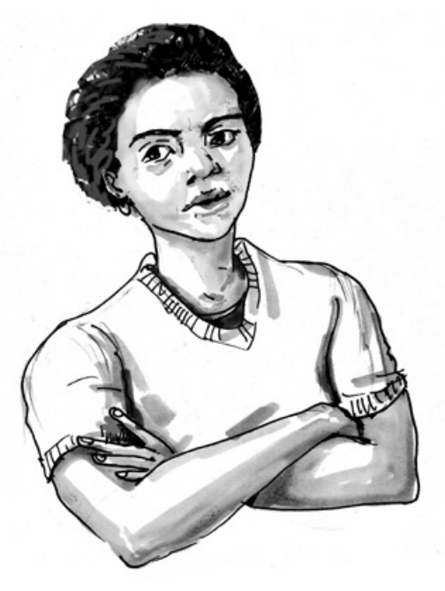
PSYCHOLOGICAL FIRST AID FOR VACCINE HESITANCY
COMMON EXPRESSIONS OF
VACCINE HESITANCY
Activity 6
Strike a pose!
I’m vaccine hesitant!
Notes:
We already discussed drivers of vaccine hesitancy, but what else can we see when looking? Sometimes just by looking at a person’s face or body language, we may be able to tell if they might be vaccine hesitant.
In a few moments I am going to ask you to strike a pose on camera of the body language and facial expression of someone who is vaccine hesitant.
[Instructions.
With consent, the trainer could also take a screen shot of everyone making the pose at the same time.
If you don’t have a camera, ask the participants to describe in a few words in the chat the facial expression or body language they might expect when vaccines are discussed from someone who is hesitant.
In the interests of time, the facilitator should call on two to three participants only by name to describe their pose and the strong emotions it represents. Also ask these participants what the needs of someone with vaccine hesitancy may be when talking to a PFA helper. Try to select poses that represent different ways of expressing emotions, including some who are negative and others who look more neutral or uncertain.]
As we can see, there is no one expression that tells us with certainty if someone is vaccine hesitant and it is not uncommon for people to initially hide that they are vaccine hesitant. However, observing the facial and body expressions can give us guiding clues about how best to approach and respond to the person in front of us in a manner that is safe and helpful.

Slide 19
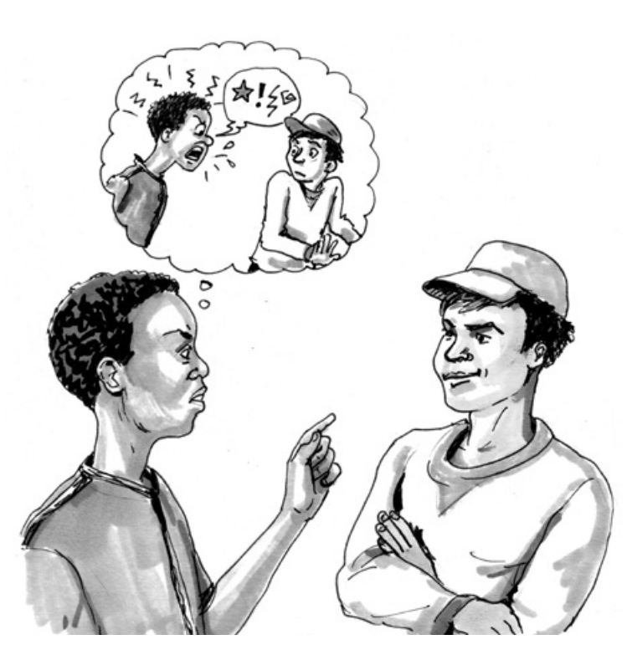
PSYCHOLOGICAL FIRST AID FOR VACCINE HESITANCY
STRONG NEGATIVE REACTIONS
Activity 7
What strong negative reactions
do you think you could or might encounter?
Write in the chat.
Notes:
An additional consideration to LOOK for with vaccine hesitancy is to look out for strong negative reactions from those we are working with. Some people have invested a lot of time in researching their vaccine hesitant beliefs or may have invested a lot in terms of strained or broken relationship with friends, family or their community. Additionally, they may have encountered a lot of judgement from others who are not vaccine hesitant. These experiences can leave someone primed with strong negative emotions – emotions that may pose a risk to your safety, or a risk to their safety – and emotions that could get in the way of supportive and effective PFA.
What strong negative reactions do you think you could or might encounter? Write some in the chat now.
[The facilitator should note a few examples from the chat.]

Slide 20
PSYCHOLOGICAL FIRST AID FOR VACCINE HESITANCY
EXAMPLES OF STRONG NEGATIVE REACTIONS
Menacing or hostile facial expression
Aggressive or threatening body language
Agitated, constantly moving
Raised voice or shouting
Showing strong feelings of superiority or contempt for people with other views
Hostile or overly combative verbal expression
Notes:
[Read/show the list]
Here are some examples of strong negative reactions that I have thought about.
People who are vaccine hesitant are not especially known for being hostile. The research shows they are more likely to hide their views. However, as a safety precaution, we should be prepared for these and other negative reactions when discussing vaccines with people who are hesitant.

Slide 21
PSYCHOLOGICAL FIRST AID FOR VACCINE HESITANCY
LISTEN REFERS TO HOW THE HELPER
Initiates contact and introduces themselves
Pays attention and listens actively
Accepts and validates the persons reactions and feelings
Calms the person in distress
Asks about needs and concerns
Helps the person find solutions to their immediate needs and problems
Notes:
The second action principle of PFA is LISTEN. In additional to the key principles and actions of LISTEN as listed on the slide are four additional considerations for vaccine hesitancy:
Listen – a lot, and listen actively
Maintain an effective dialogue
Provide ‘useful’ information, and
Provide perspective and encourage having an open mind
We will go over these additional factors now in more detail now.

Slide 22
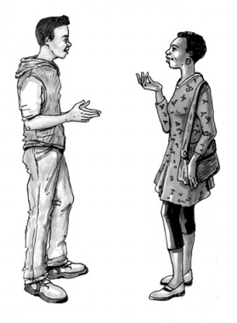
PSYCHOLOGICAL FIRST AID FOR VACCINE HESITANCY
SPECIAL CONSIDERATIONS FOR LISTEN
Stay in your role as a supportive listener
Be prepared to listen open and actively – a lot
Maintain a supportive and helpful dialogue
Foster trust and respect
Find common ground
Validate their genuine concerns
Take time to understand what people are thinking
Listen
Ask non-judgemental questions
Find out gaps in understanding
Notes:
The four main additional areas for LISTEN are to: [Adapt the below text as required. You may wish to shorten the text also.]
Stay in your role as a supportive listener, and to be prepared to listen – a lot.
Your role is to provide support and calming to the person. It is not to change someone's mind on vaccines. It is therefore important that you stay focused on being supportive (not judgmental or combative) and on providing a sense of calming
It is also important to be ready to listen – and ready to listen openly and actively. Friends, family and other supports may have closed their ears to listening to them talk about their hesitancy around vaccines. Alternatively, the person may have been scared to disclose their vaccine hesitancy to anyone before and you are the first person who they have opened up to. Listening, and listening actively, is important to building a respectful relationship and providing effective PFA.
A supportive and helpful dialogue is always important in PFA, and especially for vaccine hesitancy as people are bringing concerns that may go against mainstream thinking. Maintaining an effective dialogue when discussing vaccine hesitancy relies on:
Building and maintaining trust. This can be promoted by being open, honest, polite and respectful. It is also important to remember one of the reasons why people can be vaccine hesitant is due to a lack of trust or suspicion of those developing or administering the vaccine. Therefore, building trust within the PFA relationship is even more important as underlying mistrust towards the vaccine and those delivering or supporting it may be present.
Find common ground. It is easier to open-up to someone once we have established that we are similar in some way. People will have different common ground, but there is always common ground. Maybe its that you are both afraid of COVID or dislike it, or that you were both sceptical of the COVID vaccine at first, or that you both have children or both like cats. Finding common ground builds connection and connection is a trait that all humans seek. It is not unusual for vaccine hesitant people to be isolated, so this makes building the connection even more important.
Validate their genuine concerns. Its normal and healthy to have some degree of scepticism about things that are new. There are also many things that are unknown about the COVID vaccine. A helpful and respectful dialogue acknowledges and validates people´s genuine concerns about the vaccine. Acknowledgement and normalising of genuine concerns, done well, has a calming effect. One of the key goals of PFA is to promote calming so people feel more supported to make decisions that will be beneficial for themselves.
Take time to understand what people are thinking and why. You can't maintain an effective dialogue if you don’t know what people are truly worried about. When working with vaccine hesitancy a three-step method to gaining understanding is to:
Listen to them. Allow them to express their thoughts and feelings.
Ask them non-judgmental questions to find out their perspectives
Finding at what point they think the myths around the COVID-19 vaccine are just silly can be useful here, but it is not always necessary
Find out what the gaps are in their understanding, so you can provide ‘useful’ information later.

Slide 23
PSYCHOLOGICAL FIRST AID FOR VACCINE HESITANCY
SPECIAL CONSIDERATIONS FOR LISTEN
Provide ‘useful’ information
Relevant information they are missing
Factual information
Information which highlights misinformation or wrong conclusions
Plausible alternative explanations for errors or myths
Provide perspective and encourage an open mind
Be open yourself
Ask perspective gaining questions
Notes:
Provide useful information. The research on supporting people who are vaccine hesitant shows that ‘useful’ information is:
Information they are missing
Information that is relevant to their specific concerns
Factual information. This may include providing links to reliable sources of information relevant to their concerns. Or explaining why their references are not reliable.
Information that highlights misinformation or wrong conclusions they have raised or that are common to vaccine hesitancy myths they hold
Providing plausible alternative explanations
Provide perspective and encourage an open mind
Be open yourself. Research shows that modeling the behavior you want someone else to show is one way to elicit it.
A proven effective and helpful way to promote an open mind is to respectfully provide a little bit of information (rather than a large amount) and allow space for the person to question their beliefs without feeling belittled embarrassed or overwhelmed.
Provide perspective by asking questions that promote perspective and test the plausibility of any conspiracy theories. For example: “who would benefit from that theory? (for example, dangerous vaccines, women becoming sterile…)?” “How would that theory work?” “How is that theory plausible?”

Slide 24
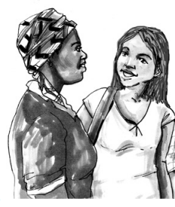
PSYCHOLOGICAL FIRST AID FOR VACCINE HESITANCY
WORKING RESPECTFULLY WITH MISINFORMATION
A simple four step process:
Start with the fact.
Warn about the myth. Mention it only ONCE.
Explain the misbelief or misconception.
Finish with the fact. Say it multiple times if possible / as appropriate.
Notes:
When providing useful information that tackles a myth or misinformation, there are good and bad ways to do this. Here is a validated good way: it’s a simple four step model to tackle misinformation. It is based on what has been shown to be effective when working with conspiracy theories and myths. It’s also based on the science of the mind which remembers information that is presented first (primacy), last (recency) and often (frequency). Our goal is that remember the fact, not the myth.
Start with the fact.
Warn about the myth. Mention it only ONCE.
Explain the misbelief or misconception.
Finish with the fact. Say it multiple times if possible / as appropriate
This method also relies on the way the information is presented – that is, the information should be presented in a polite, clear, respectful and non-judgemental manner.
Here is an example of the four-step method in action when tackling the myth that COVID-19 vaccines give you COVID
Start with the fact. You can't get COVID-19 from taking the vaccine.
Warn about the myth. A myth has been circulating widely on social media that the vaccine gives you COVID, but this is not true.
Explain the misbelief or misconception. The reason why you can't get COVID-19 from the vaccine is because the vaccine doesn’t contain any live virus.
Finish with the fact. Because there is no live virus in the vaccine, it is not possible to get COVID from the vaccine.
In this demonstration, I repeated 3 times the correct information – that you can not get COVID from the vaccine – and only once mentioned the myth. The myth came with a pre-warning and was in the middle of my short spiel - so the myth is the information that our brains are least likely to remember in this example. The explanation for why the myth is not possible was clear and simple. I could have expanded this explanation further if the person I was working with had follow-up questions.
It is however, best to keep the explanation simple - unless there is a specific request for more information - because when people are anxious, they can not absorb a lot of complex information and they can become confused. Also, when we are anxious, we tend to remember information that strengthens or aligns with our fears. To conclude, I finished with the fact - that it is not possible to get COVID from the vaccine – to really reinforce this point.

Slide 25
PSYCHOLOGICAL FIRST AID FOR VACCINE HESITANCY
4 STEPS TO WORKING WITH MISINFORMATION
Activity 8
Use the 4-step method to tackle one of these myths. Everyone has a turn.
COVID-19 vaccine development was rushed and unsafe
COVID-19 vaccines cause sterilization
COVID vaccines change or interact with DNA
COVID-19 vaccines are safe for everybody
Notes:
Now it is your turn to try applying to four step method to tackle misinformation. Remember to keep it simple, focus on the facts, and be polite, honest and respectful. It is OK if you don’t know the answers to all these myths. In preparing to work with people who are vaccine hesitant, you should gather information to refute myths common in your area, but of course there will be myths that you have never heard of before. Then you just be honest about that for example, by saying “this is not something I have heard about before”.
[Divide people into groups using Zoom breakout rooms or similar. Put the four steps summary and the instructions for the activity in the chat so they are available to participants while in the breakout room. If breakout rooms are not possible due to technology, you can also ask for a volunteer to try using the four-step method while others watch on.]
[After the group work, call on two to three people by name and ask how it was to use the four-step model for working with misinformation, for example, did it make it easier to have a frame to tackle misinformation? Also ask how it felt to receive information in this way, for example did it feel respectful and easy to digest the information.]

Slide 26
PSYCHOLOGICAL FIRST AID FOR VACCINE HESITANCY
LINK IS TO
Assess information
Connect with loved ones, and social support
Tackle practical problems
Access services and other help
ADDITIONAL CONSIDERATIONS INCLUDE
Address unreliable sources of information
Recognise that loved ones and community may be rejecting this person
Notes:
Again, the LINK actions for vaccine hesitancy are the same as for other situations of offering PFA, however some key additional areas to consider when linking are to:
Address unreliable sources of information.
Again, remember to be polite and respectful when doing so, and to provide alternative sources of information that are reliable.
Recognise that loved ones, friends, work colleagues and community may be rejecting this person.
Therefore, it is important to encourage being in touch with loved ones, while also respecting that they have different views. Reiterate the importance of focusing on common ground, and other empathy building strategies that you have learned in this training accepting or for understanding others with different viewpoints.
Alternatively, it may be more helpful to link the person with other supports such as a helpline for COVID vaccines.

Slide 27
PSYCHOLOGICAL FIRST AID FOR VACCINE HESITANCY
PUTTING IT ALL TOGETHER
Activity 9
Listen to the role play
What things did the helper do well?
What advice could you give the helper?
Notes:
[Participants listen to a recorded audio file, or for lower tech or if preferred, participants listen to two people reading a scripted role play (Suggested role play script below. Adapt as required). The role play demonstrates the “right way” to provide PFA to someone who is vaccine hesitant. It covers all three PFA areas. The basic outline for the scenario is as follows: an adult from a COVID vaccine minority group shows up to Red Cross open interview hours and seems anxious. At first the PFA helper doesn’t know why they are there. Through actively listening it is uncovered that the person is COVID-19 vaccine hesitant and looking for someone supportive to talk to. This is the first time they have openly discussed the issue of vaccine hesitancy with anyone. Their main concern is around the safety of the vaccines and that it is not tested on their minority group. It appears that they have not received much trustworthy information on the COVID vaccines. They also raise that they are feeling isolated from friends who have different views on COVID vaccination.
After the role play is read out, ask participants reflect on:
- What things did the helper do well?
- What advice could you give the helper ?
After a few minutes' reflection time, call on several people by name to open their microphone and provide these reflections to the group.
After the feedback from participants, the facilitator may wish to recap by noting things done well such as:
- the helper responds to questions, concerns and doubts related to the COVID vaccination with respect
- the helper encourages the person to seek facts from trusted sources
- concerns are validated about the vaccines not being tested on certain minority groups, reducing anxiety over this somewhat
- the helper encourages the person to explore ways of maintaining friendships, if possible, by focusing on common ground
- the person reports feeling more confident about where to look for reliable information on COVID vaccines
- the person reports a sense of self efficacy to solve their own problems]
Scripted role play. Adapt to fit the local circumstances.
Jazmin: Hi. Is there someone here I can talk to?
PFA helper: Hi. My name is Mel and I work at the Icelandic Red Cross in psychosocial support. Did you want to talk to me or tell me briefly what you want to talk about so I can find the right person to assist you?
Jasmin: I’m not feeling very good. I feel very stressed, and I have a tight feeling in my chest. I don’t know who to talk to about my worries.
PFA Helper: I’m sorry to hear that that you are not feeling very good. I’m glad you have reached out and come to talk to someone. Would you like to tell me a bit more about the tight feeling in your chest and your worries so I can better understand how I might be able to support you?
Jasmin: Yes. Do you know much about the COVID vaccine? And what do you think about people who haven’t taken it?
PFA Helper: I’ve learnt quite a lot about the COVID vaccines – mostly by reading the information on the World Health Organisation webpages and other trusted sources. I also know there a lot of reasons why people may delay having the vaccine or decide not to get it. I also know that its normal to feel unsure or hesitant about new things.
Jasmin: (breathes a sigh of relief). OK, then I think I can talk to you. You see, I haven’t taken the vaccine yet even through I’ve been offered it. I’m getting a lot of pressure from my friends to have the vaccine and they say they will stop speaking to me if I don’t have it. It’s making me feel really stressed and overwhelmed.
PFA Helper: Am I hearing correctly that you are feeling a lot of pressure from your friends to have the vaccine and they are even saying they might stop speaking to you, yet you are not sure if the COVID vaccine is right for you. Is that correct?
Jasmin: Yes. I’ve been reading a lot of things about how unsafe it is. And it makes me feel even more worried knowing that it hasn’t been tested on my ethnic group.
PFA Helper: It’s good to hear that you have been seeking out information to try and make an informed decision that feels right for you. And you are right, the vaccines we are being offered have not been tested on your/our specific ethnic group. Its normal that you have questions about if it is safe for you.
Jasmin: So, its normal to have these questions? That’s good to know. I thought maybe I was the only one as most of my friends have already had the vaccine and they are pulling away from me because I haven’t accepted it yet.
PFA Helper: Yes, it’s completely normal. I had questions myself and that’s why I sought out reliable information so that I could feel comfortable about the decision that was right for me. Can I ask where you are getting your information from? I am asking as there is a quite a lot of misinformation out there so I just want to make sure you are getting the most accurate information so you can make the best decision for yourself.
Jasmin: Mostly it’s from this Facebook page that is for people against vaccines. There are all kinds of conspiracy theory information on the page, some of it is pretty outrageous actually.
PFA Helper: The best place to get accurate and up to date information about COVID vaccines is from trustworthy sources of information like the World Health Organisation or the local official government webpage that has fact checked information and information about the vaccines specifically in our community. I can show you these websites if you are interested. The government page also has a chat-box function where you can ask any question anonymously about the COVID vaccines and a nurse will answer your questions.
Jasmin: Being able to get information straight from a nurse and in my own language sounds very good. Can you show me how to use the chat function on the website?
PFA Helper: Of course. Is there something else you wanted to talk about today? You mentioned you are feeling stressed and maybe becoming isolated from your friends?
Jasmin: It’s such a big problem, and I have no idea what to do. My friends are normally such a great support to me, but I’ve started to avoid them in case they ask me about vaccination and start pressuring me. I’m feeling pretty alone and isolated.
PFA Helper: Friendships are so important to us as human being. Is this something you and your friends have faced before – having a different viewpoint on a topic but still being able to enjoy each other’s company?
Jasmin: Well, when you put it like that, yes actually. We have different opinions on how home responsibilities should be shared between couples, but we are still great friends and can respect each other’s different viewpoints.
PFA Helper: It sounds like you have good experience in your friendship for accepting differences. Do you think you could build on that common ground you share in your friendship and approach this issue in the same way – that you have different opinions on the COVID vaccine, but can still be friends in other ways?
Jasmin: Yes. I will talk to my friends about it. It makes me feel more confident to address this problem when you frame it like this. Also, I feel a lot calmer now that I know I can contact the local COVID line to talk to a nurse and visit the website to find accurate information. Thank you.
PFA Helper: You’re welcome. Thanks for coming to speak with me today. If you want to come again and speak to someone in person at the Icelandic Red Cross you can always come back on Thursdays between 12 and 2pm.

Slide 28
PSYCHOLOGICAL FIRST AID FOR VACCINE HESITANCY
CREATING A SAFE SPACE
Activity 10
What things can the PFA helper do to create a safe space? A space that promotes safety, calming, self-efficacy and social connectedness.
Notes:
It is important to create a safe space for people so that they can talk about their fears and worries; ask questions about the COVID-19 vaccine; and receive answers to those questions. Doing this will help create a sense of calming and wellbeing which is the ultimate purpose of PFA.
Safety involves not only physical safety, but social and emotional safety. While the focus on safety will vary with different people, the goal is always the same - that the person is safe and the person feels safe.
Calming. The goal of the PFA helper is to promote a calming effect, so the vaccine hesitant person can move from being reactive, defensive or closed off, to feel more calm, in control and able to proactively engage with their vaccine hesitancy fears and make an informed decision about the COVID-19 vaccine that they feel comfortable with.
Self-efficacy is created when people feel more in control of their own destiny and their decisions and that something is not being imposed on them, rather they are deciding it themselves.
Decades of research has shown that is it the quality of the relationship – also known as the therapeutic alliance - between a helper and the person they are supporting, that allows a person to move through difficulties and enact change. Therefore, building trust and social connectedness is key. Humans crave interpersonal connection and the sense of belonging. As we already mentioned, it is not uncommon for a person who is vaccine hesitant to have weakened relationships with friends, family and community or fear their rejection. Building interpersonal connection in the PFA relationship can be the start of restoring interpersonal connection.
[Break the into small groups or pairs, using Zoom breakout zooms or similar if available, to discuss what the PFA helper can say and do to create a safe space for people who are vaccine hesitant. Allow 5-10 minutes. Call on a few people by name to provide feedback on behalf of the group they were in.]

Slide 29
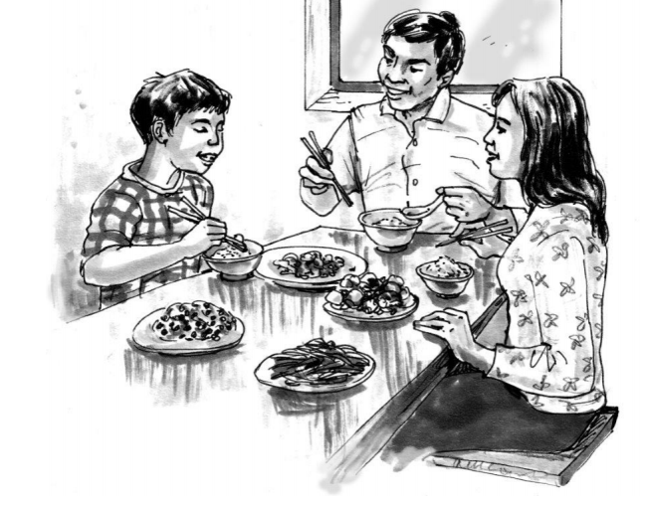
PSYCHOLOGICAL FIRST AID FOR VACCINE HESITANCY
CREATE A SAFE SPACE
Be fully present
Show acceptance, empathy and compassion
Be open and allow for diversity of opinions
Respond to needs, questions and concerns
Clearly explain and provide only accurate information
Ensure confidentiality
Notes:
A few things that I have thought of to promote safety, calming and connectedness are:
Safety can be provided through how the helper shows acceptance, empathy, and compassion. For example, by being open and respectfully allowing for diversity of opinions. Safety can also be developed through ensuring any information about vaccines that the PFA helper provides is accurate and reliable.
As humans are social beings, they will carefully study how the PFA helper presents themselves - their mannerisms, tone of voice and body language. Therefore, it is important that we are fully present, pay attention and are respectful in our interactions. It is the vaccine hesitant person who ultimately determines if you are a safe person to reveal concerns to, and if you seem trustworthy enough for them to listen to you and accept your guidance.
The primary goal for all PFA helpers working with people who are vaccine hesitant is to be responsive to their needs. PFA helpers need to respond to needs, instead of reacting adversely to the person’s distress. During times of high emotional arousal (for example, when the person is angry, fearful, or disappointed), the PFA helpers' role is to help restore calm. This might be through a calming or grounding exercise, or by using other techniques to promote calm such as tone of voice, allowing for comfortable silence, and respectful debunking rumors or misinformation that is causing distress.

Slide 30
PSYCHOLOGICAL FIRST AID FOR VACCINE HESITANCY
Final activity
What are your most important learning points that you are taking away with you today?
THANK YOU AND
GOODBYE!!
Notes:
Thank you very much for your active participation in this training on PFA for vaccine hesitancy to the COVID-19 vaccine.
Our final activity for today is to share what your most important learning points are that you are taking away today.
[Ask people to share in the chat, or if preferred through another platform such as mentimeter.com their most important learning points.
Farewell participants and thank them again for their active participation.]

Slide 31
PSYCHOLOGICAL FIRST AID FOR VACCINE HESITANCY
Author: Melanie Powel
Illustrations: Carole Howes

