Slide 1
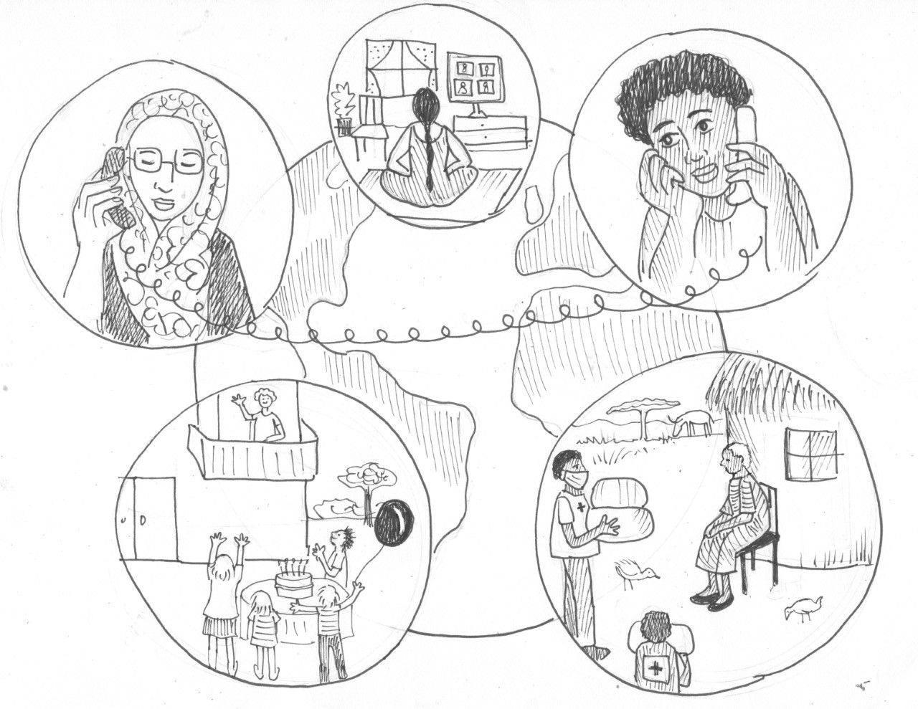
PSYCHOLOGICAL FIRST AID
FOR PANDEMIC FATIGUE
IN THE COVID-19 OUTBREAK RESPONSE
Notes:
[Present yourself, your organization, and your role. See the example below. Adapt to details of the facilitator.]
Hi, my name is XXXXXX. and I will be your facilitator for the day.
Welcome to this short training module on PFA for pandemic fatigue. This is an additional module to the basic training on psychological first aid in the COVID-19 outbreak response for staff and volunteers in Red Cross and Red Crescent National Societies. It is developed for people who have taken part in the basic training and have foundational knowledge of PFA and how it can be applied in the response to the COVID-19 crisis.
[Provide technical information about how the training will function. See the On-line facilitation in Mental Health and Psychosocial Support for more on this: https://pscentre.org/on-line-facilitation-in-mental-health-and-psychosocial-support/
For example, if using ZOOM here are some things to explain:
Breakout rooms
Mute when not speaking
Raise your hand electronically if you want to speak
Write short comments in the chat box.
Get into the breakout rooms to observe the interaction of the participants
Please be aware that this workshop will be recorded for training purpose. Please indicate if you're not okay with the recording.
A good practice with online trainings is to manage feedback and pick on random people to contribute. See below for an example of what you can say:
“During the training when we have feedback sessions, I will pick you randomly and ask for your input, to make sure everyone gets a chance to contribute. If you have something very important you want to add after your colleagues have shared, raise your hand and we will see if we have time for more input.’
I would now like to give each of you about 30 seconds to introduce yourselves [Choose an appropriate duration for each participant depending on how many people are taking part. Don’t spend more than 5 minutes on this.] Please say your name, where you work and why you chose to join this training.]

Slide 2
PSYCHOLOGICAL FIRST AID FOR PANDEMIC FATIGUE
Learn about the concept of pandemic fatigue and understand how PFA skills can help support people who are experiencing pandemic fatigue due to COVID-19.
Build or deepen skills in demonstrating empathy and understanding of pandemic fatigue.
AIM OF TRAINING
Notes:
The aim of this training module is for participants to first learn what pandemic fatigue is as well as some of the more common signs of it.
Later we will then learn or deepen the psychological first aid skills to supportively respond to people who are experiencing pandemic fatigue.
The module is also helpful when supporting or guiding someone who, due to experiencing pandemic fatigue, is feeling demotivated to adhere to health seeking behavior and the training will build on deepening the PFA provider skills in demonstrating empathy and understanding.

Slide 3
PSYCHOLOGICAL FIRST AID FOR PANDEMIC FATIGUE
Reasons that people experience pandemic fatigue
TRAINING CONTENT
PFA for pandemic fatigue: Look, Listen and Link
Promoting public health measures, Protective behavior, Self-efficacy and Connectedness
Notes:
The training module will cover:
The factors that influence people’s experience of pandemic fatigue
We will discuss the factors that influence people's public health behavior as well as the three PFA principles of Look, Listen and Link as they directly relate to supporting people with pandemic fatigue
And discussions on ways to promote safety, calming, self-efficacy, and connectedness to help people with pandemic fatigue

Slide 4
PSYCHOLOGICAL FIRST AID FOR PANDEMIC FATIGUE
WHAT IS PANDEMIC FATIGUE?
Activity
Share your opinion in the chatbox
Notes:
The workshop of today is all about 'pandemic fatigue'. To begin with our workshop, it's good for us to have a concept of pandemic fatigue in our mind. So, have you ever heard of pandemic fatigue? What is pandemic fatigue?
Let the participants share in the chat box what their understanding of Pandemic Fatigue is.
After having had a few examples in the chat box explain the following:
We will now put you into breakout rooms and give you 5 mins to discuss, and then kindly nominate 1 person from your group to share what you discussed in plenary.

Slide 5
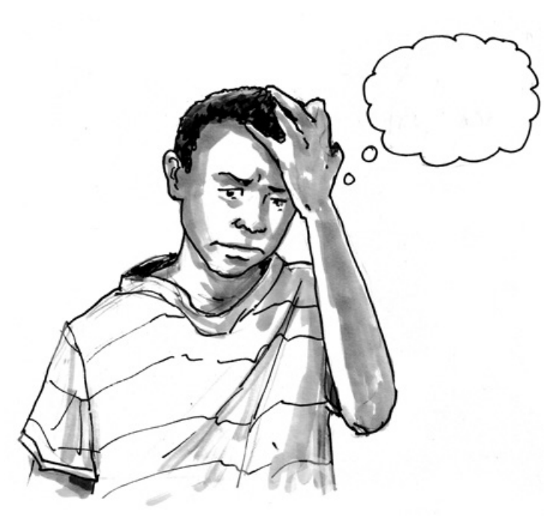
PSYCHOLOGICAL FIRST AID FOR PANDEMIC FATIGUE
WHAT IS PANDEMIC FATIGUE?
WHO defines Pandemic Fatigue as “An expected and natural response to a prolonged public health crisis .”
Pandemic Fatigue expresses itself as emerging demotivation to engage in protection behaviours and seek COVID-19-related information and as complacency, alienation and hopelessness.
Notes:
WHO (the World Health Organization) defines Pandemic Fatigue as “An expected and natural response to a prolonged public health crisis .”
They define pandemic fatigue as an emerging demotivation to engage in protective behaviours and seeking updates and information on COVID-19. Pandemic fatigue can also express itself as feelings of hopelessness and a sense of alienation and can in some cases also lead to complacency.
Take a moment to reflect on this definition. How does this definition resonate with you? Can you recognize it? Do you agree, disagree, or have questions? [If using a camera ask for a thumbs up or thumbs down or a flat hand shaking response, if no camera ask to write in the chat ‘agree’ or ‘disagree’ ‘not sure’. Then call specifically on 2-3 people only to comment and ask them for their reflections on the definition.

Slide 6
PSYCHOLOGICAL FIRST AID FOR PANDEMIC FATIGUE
3 COMPONENTS OF PANDEMIC FATIGUE
AFFECTIVE FACTOR
COGNITIVE FACTOR
fdsfds
BEHAVIORAL FACTOR
Depressed Mood
Hopelessness
Anxiety
Numbness
Boredom
Information Overloaded
Physical Exhaustion
Experienced Hardship
Sleep Hygiene
Awareness
Risk Perception
Perceived Susceptivity
Perceived Severity
Trust
Attitude
Self-Efficacy
Complacency
Perceived Inconvenience
Level of engagement in hygiene and social distancing behaviors
Coping behaviors towards managing stress
Notes:
According to a survey on pandemic fatigue conducted by the Hong Kong Red Cross Branch of the Red Cross Society of China, pandemic fatigue is not only a mental health problem but also closely related to public health aspects. The causes of "Pandemic Fatigue" were found to have multiple components of different aspects, instead of the single factor that people were "tired out physically and mentally under the prolonged pandemic".
Three components were discovered as the factors of "pandemic fatigue": "Factor 1: Affective Factor ", "Factor 2: Cognitive Factor ", and "Factor 3: Behavioral Factor in Public Health Measures".
Let us take a closer look at the 3 defined factors.
The Affective factor is more related to our emotions (name a few of the examples from the table)
The Cognitive Factors relates more to the way we think and reason (name a few of the examples from the table)
And lastly the behavioral factor.
Take a moment to reflect on these three factors. What comes to mind when you see them? Do you see the linkage with pandemic fatigue based on these factors?,
[If using a camera ask for a thumbs up or thumbs down or a flat hand shaking response, if no camera ask to write in the chat ‘agree’ or ‘disagree’ ‘not sure’ if the linkage resonates with them. Then call specifically on 2-3 people only to comment (ensuring one agree and one disagree respondent if possible) and ask them for their reflections on the factors.]

Slide 7
PSYCHOLOGICAL FIRST AID FOR PANDEMIC FATIGUE
WHAT ARE THE COMMON SIGNS
OF PANDEMIC FATIGUE?
Activity
List some common signs of pandemic fatigue in the chatbox
Notes:
Let’s start by looking at some common signs of pandemic fatigue.
Share in the chat or unmute yourself and share some of the signs that you might have heard, or think would be common when talking about pandemic fatigue. You don’t have to agree with them, just list or share what you might have heard.
**Any signs of pandemic fatigue happen in your national society (particularly)?

Slide 8
PSYCHOLOGICAL FIRST AID FOR PANDEMIC FATIGUE
COMMON SIGNS OF PANDEMIC FATIGUE
Not being as diligent with mask wearing and hand washing
Being less careful about physical distancing
Getting enough sleep but still feeling exhausted
Feeling more impatient and more irritable
Finding things are upsetting that previously weren’t
Feeling stressed by tasks or situations you usually manage well
Not engaging in things that used to be enjoyable
Consumption of alcohol, substances and food has increased
Notes:
Here are some of the signs that I have heard about when looking at pandemic fatigue.
[Read out or show the slide with some common signs. Adjust the PowerPoint to reflect signs the presenter has heard about. Comment on how the signs on this PowerPoint link or overlap - or don’t! - to the signs that the training participants produced in the previous exercise.]
It is important to note that while some signs may be shared, and some may be culturally specific, other signs will be unique to each individual. This is why we should take the time to listen closely and actively so we can better understand people´s unique signs of pandemic fatigue. It is only then that we are able to respond respectfully and provide information, calming and support to people who are experiencing pandemic fatigue .

Slide 9
PSYCHOLOGICAL FIRST AID FOR PANDEMIC FATIGUE
WHAT POTENTIAL PROBLEMS COULD OCCUR DUE TO PANDEMIC FATIGUE?
Activity
Share your opinion with your groupmates
Notes:
In this part, we’re going to talk about the potential problems under pandemic fatigue. Is there any short-term or long-term consequences people might face when dealing with pandemic fatigue? Try to put yourself into their shoes and think about both some short term and long term problems that might occur.
In the following 7 mins, I would like you to go into breakout room and share your thoughts with your groupmates. After that, please nominate someone in your group to share the points in the whole group.
Any Questions?
See if the participant could understand the instruction: can invite them to show the emoji (e.g., thumb up/thumb down) to indicate their understanding.
--> Please further clarify if they do not understand the instruction.
Then send them all to breakout rooms with a 7min timer Get into the breakout rooms to observe the interaction of the participants
When they return go through the groups and have them share their examples before going to next slide.
Alert: Participants might mix up the concept of 'pandemic' and 'pandemic fatigue. Please recap the definition of pandemic FATIGUE for clarification.
**Pandemic Fatigue as “An expected and natural response to a prolonged public health crisis .” -- 3 components of pandemic fatigue.

Slide 10
PSYCHOLOGICAL FIRST AID FOR PANDEMIC FATIGUE
POTENTIAL PROBLEMS
UNDER PANDEMIC FATIGUE
SHORT TERM
LONG TERM
Psychological Problems
- Stress-overload
- Anxiety
Psychological Problems
- Depression
- Anxiety Disorder
- Substance Dependency
- Suicide
Behavioral Problems
- Social Conflicts / Isolation
- Substance Abuse
Global Crisis Escalation
- The continuation of COVID outbreak
Practical Problems
- Legal Consequences
- Financial Burden
Health Problem
- Higher risk of getting infected
Notes:
As mentioned earlier, pandemic fatigue a response to the prolonged exposure to uncertainty. The impact of COVID to both physical and mental health of people have been unprecedented.
Here are some more examples of short term and long-term potential problems.
* Add up anything that participants haven’t mentioned.
As you can see some consequences might have been short term while some might have been more long term. Some consequences could also have been more severe than others. While some people’s pre-existing conditions could be exacerbated by the prolonged public health crisis.
Supporting people who are experiencing pandemic fatigue involves the same three action principles in PFA, that are: Look, Listen and Link. There are however some aspects that we need to pay more attention to when working with people who are experiencing pandemic fatigue.
After the 10 mins break, we’re going over the three action principles one by one as they specifically relate to supporting people who are experiencing pandemic fatigue.
Participants might mix up the concept of 'pandemic' and 'pandemic fatigue. Please recap the definition of pandemic FATIGUE for clarification.
**Pandemic Fatigue as “An expected and natural response to a prolonged public health crisis .” -- with 3 components of pandemic fatigue.

Slide 11
PSYCHOLOGICAL FIRST AID FOR PANDEMIC FATIGUE
- LET'S TAKE A BREAK -
Notes:
Now it is time for a break. See you in 10mins. (you can set the time of the break to match your flow)

Slide 12
PSYCHOLOGICAL FIRST AID FOR PANDEMIC FATIGUE
PUBLIC HEALTH BEHAVIOR
= Efforts put in place to change people's personal habits and attitudes, to prevent disease.
HELP SEEKING BEHAVIOR
COMPLIANCE
Can you think of any compliance / help seeking behavior?
Notes:
Pandemic Fatigue can have an affect on your public health behavior. What is public health behavior?
It refers to efforts put in place to change people's personal habits and attitudes, to prevent disease. Behavior change in public health can take place at several levels and is known as social and behavior change.
In a recent Pandemic Fatigue survey for Asia Pacific, Two public health protective behavioural outcomes of the respondents were investigated namely , ‘Compliance’ and ‘Help Seeking Behaviour’,., a total of 86.1% of respondents agreed or strongly agreed that they followed public health preventive measures such as physical distancing and wearing masks indicating their Compliance,
On the other hand, 80.2% of all respondents agreed or strongly agreed that they would seek medical advice and get testing immediately if they felt unwell showing their Health Seeking Behaviour
What are some examples of Compliance or Health Seeking Behaviour that you might know of ? Let the participants share some examples either by raising their hand or in the chatbox

Slide 13
PSYCHOLOGICAL FIRST AID FOR PANDEMIC FATIGUE
The interplay of factors affecting COVID-19 protective behaviors
Contextual Opportunity
Social & Physical
Protective
Behaviors
Individual Capability
Physical & Psychological
Rights & Regulations
Workplace / School Support
Awareness
Cultural Norms, Values
Accessibility (water, sanitizer, transportation)
Mental Ability
Individual Motivation
Automatic and Reflective
Income
Peers' expectations & behaviors
(Health) Literacy
Experiences
Values & Beliefs
Risk Perceptions
Emotions
FATIGUE
Trust
Self-Efficacy
Intentions
Perceptions
Complacency
Values & Beliefs
Notes:
As suggested by the WHO interim guidance, there are always new lessons to be learnt in every public health emergency. Therefore, it is important to respond proactively with actions that are commonly known.
The model shown is the Capability-Opportunity-Motivation Behavioural model (COM-B model), which is used widely in behavioral science research to understand what influences behavior.
Contextual Opportunity refers to the external factors that affects behaviors, such as cultural norms , location and accessibility to resources.
Capability refers to the knowledge, skills and abilities needed to engage in a particular behavior.
Motivation refers to the internal processes that influences decision-making, such as our emotions and impulses, beliefs and evaluations.
Each of these factors could affect levels of adherence towards public health behaviours that prevent the spread of the COVID-19 virus. Therefore, this model was was applied in a European behavioural insights survey by the WHO, in order to understand the interplay of factors affecting protective behaviors towards COVID-19. The results can be seen here, which gives us a more comprehensive overview when trying to understand how ‘Fatigue’ plays a role in affecting the ‘Pandemic”
Conclude with explaining that different contexts and circumstances play a role in how Pandemic Fatigue can be experienced, and it is not necessarily as step-by-step process as shown above, however Pandemic Fatigue is very real and can lead to a change in our public health responses. Therefore, the COM-B model can also serve as a useful template when applying PFA principles of look-listen-link, to assess whether there are any particular contextual, motivational or capability factors that may be influencing an individual’s experience of pandemic fatigue.

Slide 14
PSYCHOLOGICAL FIRST AID FOR PANDEMIC FATIGUE
ACTION PRINCIPLES OF PFA
LOOK
LISTEN
LINK
Notes:
Supporting people who are experiencing pandemic fatigue involves the same three action principles that underpin all PFA approaches: Look, Listen and Link. Though some aspects we might need to pay more attention to when working with people who are experiencing pandemic fatigue.
We are now going to go over each of the three action principles one by one as they specifically relate to supporting people who are experiencing pandemic fatigue.

Slide 15
PSYCHOLOGICAL FIRST AID FOR PANDEMIC FATIGUE
LOOK FOR
Information on what has happened and is happening
Safety, protection and security risks
Physical injuries
Immediate basic and practical needs
Emotional reactions
Notes:
[This slide can be shown in two parts. At first, ONLY show the heading “Look for”. Then ask the questions to the participants. After they have given their answers, you can show the text of the slide.]
The actions for LOOK when providing PFA to people who are experiencing pandemic fatigue are similar to the Look actions under other circumstances.
Please write in the chatbox or unmute yourself and share what we should look out for during this action principle when offering PFA.
[Recap some of the answers from the chat while revealing the text of the slide on what to Look for.] On the slide are some things that I have thought about that we should look out for when providing PFA.

Slide 16
PSYCHOLOGICAL FIRST AID FOR PANDEMIC FATIGUE
ALSO LOOK FOR
Your own biases or views
Know your own limits as a helper
Strong reactions from people with pandemic fatigue
Look for (and be prepared to respond helpfully and respectfully to) myths or concerns
Notes:
Three additional factors to also LOOK for when working with people who are experiencing pandemic fatigue are:
Focusing closely on and managing your own biases or views as these have the potential to interfere with your ability to provide supportive PFA.
Be prepared for possible strong client reactions. Some people have invested a lot or may have been met with a lot of judgement from others about their view on the pandemic and their experience with pandemic fatigue. They may also be primed to react strongly in conversations about the pandemic.
Look for (and prepare yourself in advance to be able to respond helpfully and respectfully to) people experiencing pandemic fatigue. Such preparation includes knowing how to promote a sense of safety and being prepared to provide ‘useful’ information. We will look into both factors in more detail later.

Slide 17
PSYCHOLOGICAL FIRST AID FOR PANDEMIC FATIGUE
HOW DO YOU FEEL WHEN FACING PEOPLE WITH PANDEMIC FATIGUE?
Activity
Write down the thoughts and feelings you might have when faced with an individual expressing pandemic fatigue
Notes:
Now take some time to think about and maybe write down how you perceive an individual who is expressing Pandemic Fatigue.
I will give you about 2 minutes to think about it and then please either share it in the chat box or unmute yourself and share what you think.
After the participants have shared their thoughts in plenary follow up with explaining:
Even though it is normal to have preconceived notions about individuals expressing pandemic fatigue it is always important to check in with yourself as a PFA provider as you do not want your support to be somewhat tainted by your own opinions. Also it could be the case that you yourself are experiencing pandemic fatigue which is all the more reason to ask your self if it is the right time to give PFA support and maybe look into asking for other PFA providers to step in.

Slide 18
PSYCHOLOGICAL FIRST AID FOR PANDEMIC FATIGUE
LISTEN REFERS TO HOW THE HELPER
Initiates contact and introduces themselves
Pays attention and listens actively
Accepts and validates the persons reactions and feelings
Calms the person in distress
Asks about needs and concerns
Helps the person find solutions to their immediate needs and problems
Notes:
The second action principle of PFA is LISTEN.
Here are some key principles and actions of LISTEN. I guess most of you have heard them before. The major task in here is to approach the persons with a proper manner, listen to the persons actively, accept their reactions, and also to find out immediate solution to their concerns. In addition of that, we would like to highlight 4 additional considerations when listening to people with pandemic fatigue.

Slide 19
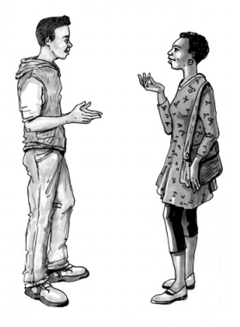
PSYCHOLOGICAL FIRST AID FOR PANDEMIC FATIGUE
SPECIAL CONSIDERATIONS FOR LISTEN
Stay in your role as a supportive listener
Be prepared to listen open and actively – a lot
Maintain a supportive and helpful dialogue
Foster trust and respect
Find common ground
Validate their genuine concerns
Take time to understand what people are feeling
Listen
Ask non-judgmental questions
Notes:
The four main additional areas for LISTEN are to: [Adapt the below text as required. You may wish to shorten the text also.]
First, your role is to provide support, understanding, and calming to the person. In order to be supportive, it’s important to be ready to listen openly and actively.
As you can imagine, their friends and family may not be willing to listen to their struggle with pandemic fatigue. Alternatively, the person may have been demotivated to express their fatigue to anyone. And at this point, you’re the first one who they feel comfortable sharing with. So, you’re not going to judge whether he/she is doing right or wrong; rather, you create a space for them to ventilate, and then, accept their reactions and feelings.
Second thing is to maintain a supportive and helpful dialogue, which is always important in PFA.
To maintain a supportive dialogue, you can promote the trust by being open, honest, polite, and respectful to the persons.
You can find common ground with the persons. It is easier to open-up to someone once we know that we are similar in a certain way. There is always common ground among people. Maybe it’s that you have both dislike the COVID, or that you both have children, or both love the MARVEL movies. It is not unusual for people experiencing pandemic fatigue to be isolated, so this makes building the connection even more important.
Besides that, you can validate their feelings. Its normal to be feeling exhausted and overwhelmed by the pandemic. There are also many things that still are quite uncertain about the pandemic. A helpful and respectful dialogue acknowledges and validates people´s feelings and experience with pandemic fatigue. Acknowledgement and normalization have a calming effect. One of the key goals of PFA is to promote calming so people feel more supported to make decisions that will be beneficial for themselves.
Well, you can't maintain an effective dialogue if you don’t know what people are truly experiencing. So, take time to understand what people are really thinking.

Slide 20
PSYCHOLOGICAL FIRST AID FOR PANDEMIC FATIGUE
SPECIAL CONSIDERATIONS FOR LISTEN
Provide ‘useful’ information
Relevant information they are missing
Factual information
Information which highlights misinformation or wrong conclusions
Plausible alternative explanations for errors or myths
Provide perspective and encourage an open mind
Be open yourself
Ask perspective gaining questions
Notes:
Provide useful information. Such useful information to people who are experiencing pandemic fatigue could be:
Psychoeducation of ‘pandemic fatigue’ / factual information that they’re missing and alternative explanation for myths.
Links to reliable sources of information relevant to their situation/experience. Or explaining why their references are not reliable.
Provide perspective and encourage an open mind
There’s a proven effective way to promote an open mind, which is to respectfully provide a little bit of information and allow space for the person to question their beliefs without feeling embarrassed.
Provide perspective by asking questions to test the plausibility of any fixed viewpoint. If the person is thinking that ‘wearing mask is not necessary’, you can guide him/her to think “How would that theory work?”, and “How is that theory plausible?”, “What is the pros and cons of taking this theory?”. Increased their mental flexibility when looking at the belief in different angles.

Slide 21
PSYCHOLOGICAL FIRST AID FOR PANDEMIC FATIGUE
BE AN ACTIVE LISTENER TO YOUR PARTNER
Activity
Take turns to share and listen to each other
Sharing topic
Your experience with pandemic fatigue
Notes:
Now we would like you to try to practice your listening skills. We will put you into breakout rooms with 2 participants per room. In the following 8 mins, you and your partner will take turns to be the service user and the listener. So for the first 4mins, one of you will be the service user, you can share an experience you might have had with pandemic fatigue; while another person as the listener, please try to use the key principles of LISTEN on the service user. After 4mins, you can switch the role with your partner, so the original listener will become the service user; he/she can share the experience with the new listener. You will find the key principles in the chat box. Are there any questions so far?
See if the participant could understand the instruction: can invite them to show the emoji (e.g., thumb up/thumb down) to indicate their understanding.
--> Please further clarify if they do not understand the instruction.
Create breakout rooms 2 participants per room. Type the LISTEN principles into the chat box for the participants to take reference from .
Get into the breakout rooms to observe the interaction of the participants
When they are finished invite them to share in plenary or in the chat box how it felt to use the key principles in this exercise, and how they felt when being listened to.

Slide 22
PSYCHOLOGICAL FIRST AID FOR PANDEMIC FATIGUE
- LET'S TAKE A BREAK -
Notes:
Now it is time for a break. See you in 5mins. (you can set the time of the break to match your flow)

Slide 23
PSYCHOLOGICAL FIRST AID FOR PANDEMIC FATIGUE
LINK IS TO
Assess information
Connect with loved ones, and social support
Tackle practical problems
Access services and other help
ADDITIONAL CONSIDERATIONS INCLUDE
Address unreliable sources of information
Recognize that loved ones and community may be rejecting this person
Notes:
Again, the LINK actions for pandemic fatigue are the same as for other situations of offering PFA, however some key additional areas to consider when linking are to:
Address unreliable sources of information.
Again, remember to be polite and respectful when doing so, and to provide alternative sources of information that are reliable. Try to refrain from using words like myth busting as it can devalue a person's experience.
Recognise that loved ones, friends, work colleagues and community may be rejecting or avoiding this person.
Therefore, it is important to encourage being in touch with loved ones, while also respecting that they have different views and experiences. Reiterate the importance of focusing on common ground, and other empathy building strategies that you have learned in this training about accepting or on understanding of others with different viewpoints and experiences.
The rejection could also stem from the person following the rules and being looked down upon because of it. Pandemic Fatigue can preent itself in different stages, so it is important also to take that aspect into account when providing support
Alternatively, it may be more helpful to link the person with other supports such as a MHPSS helpline or a referral to a MHPSS professional.

Slide 24
PSYCHOLOGICAL FIRST AID FOR PANDEMIC FATIGUE
REGARDING LINK, WHAT DO PEOPLE WITH PANDEMIC FATIGUE NEED?
Activity
List out their possible needs that we can link / provide.
Notes:
Regarding LINK, what do people experiencing pandemic fatigue might possibly need? What can we link in response to their needs?
Share in the chat [Or use a program such as mentimeter.com to make an interactive word cloud or list] some of the possible needs and resources we could provide people who are experiencing pandemic fatigue with. You don’t have to be completely certain but just list out the ones you think would be beneficial to provide.

Slide 25
PSYCHOLOGICAL FIRST AID FOR PANDEMIC FATIGUE
ENGAGING WITH PEOPLE WITH PANDEMIC FATIGUE
Activity
Role play
Notes:
Participants listen to two people reading a scripted role play (Suggested role play script below. Feel free to adapt the scenario to your context/culture).
The role play demonstrates the “right way” to provide PFA to someone who is experiencing pandemic fatigue. It covers all three PFA areas. The basic outline for the scenario is as follows: a young adult who has been dealing with pandemic fatigue shows up to Red Cross open interview hours and seems exhausted. At first the PFA helper doesn’t know why they are there. Through actively listening it is uncovered that the person is experiencing what seems to be pandemic fatigue and looking for someone supportive to talk to. Their main concern is around the challenges at home with differing views on the pandemic and the threat of being kicked out of the house due to not following the public health measures.
After the role play is read out, ask participants to reflect on:
- What things the helper did well?
- What advice you could give the helper ?
After a few minutes' reflection time, call on several people by name to open their microphone and provide these reflections to the group.
After the feedback from participants, the facilitator may wish to recap by noting things done well such as:
- the helper responds to questions, concerns and doubts related to the experience of pandemic fatigue with respect
- the helper reminds the person about their own resilience of coming to the facility asking for support and encourages the person to explore ways of maintaining friendships, if possible, by focusing on common ground
- the person reports feeling more confident and reassured that what they are feeling is normal
Scripted role play. Adapt to fit the local circumstances.
Jazmin: Hi. Is there someone here I can talk to?
PFA helper: Hi. My name is Andy, and I work at the Hong Kong Red Cross with the psychosocial support team. Do you want to talk to me or tell me briefly what you want to talk about so I can find the right person to assist you?
Jasmin: Hi Andy. I'm not feeling good. I'm exhausted from the COVID restrictions. They make me think that I am trying to survive rather than live…
PFA Helper: I'm sorry to hear that you are not feeling good. I'm glad you have reached out to come and talk to someone. Would you like to tell me a bit more about your thoughts and feelings so I can better understand how I might be able to support you?
Jasmin: Well, this pandemic has been going on for years; I know that everyone is trying to fight the COVID, but I'm no longer motivated to adherence to the COVID restrictions and policies…oh wait! Would you consider me a freak if I tell you this?
PFA Helper: It seems like you're frustrated with the pandemic, and this frustration has diminished your motivation to follow the COVID health and safety policies lately. As you've said, this pandemic has lasted for over 2 years. It's normal for us to have similar experiences, so no worries, I would not judge you by that.
Jasmin: (breathes a sigh of relief). OK, then I think I can talk to you. Actually, I was super worried about being infected at the beginning of this pandemic. I used to strictly follow the policies to protect myself, such as wearing masks, keeping hygiene, and physical distancing. But gradually, I was numbed with pandemic news and policies. Rather than maintaining physical distance, I would hang out with friends for fun, and I don't carry the hygiene as well as before. Because of that, I'm getting pressure from my family. They believed that I was escalating their risk of infection. They asked me to stop hanging out, or they woul kick me out from the house. They don't really understand me. I just want to maintain my social life...
PFA Helper: Right. It's understandable to feel numb after having been exposing to the pandemic and all its restrictions for such a long time. It seems like you want to lighten up your mood via social gatherings. However, your family disagree with your actions, making you feel pressured and upset. Am I correct?
Jasmin: Yes! Our family has had many arguments over this topic, making me feel bad. Apart from that, I can't focus on work lately. I keep feeling tired even after sleeping 9 hours. This is the worst condition ever in my life. I don't know what is happening to me….
PFA Helper: Oh, I'm sorry to hear that. It's a hard time for you, and no wonder you would feel stressed and frustrated recently. Regarding your condition, have you ever heard of the term pandemic fatigue?
Jasmin: No, not really.
PFA Helper: Well Pandemic fatigue is a natural response to a prolonged public health crisis. When faced with something that feels like a never-ending pandemic, it's normal for us to be emotionally drained due to the the uncertainty and restrictions such as the ones due to COVID 19. People with pandemic fatigue might experience depressed moods, sense of helplessness, numbness, and physical exhaustion. Due to the 'fatigue,' they might perceive the pandemic as less severe, and thus, they would be demotivated by the COVID restrictions.
Jasmin: So, it's normal to have these feelings? That's good to know. I thought I was abnormal as all my family members criticized my behavior.
PFA Helper: Yes, it's expected under stress, but it's not happening to everyone, and it causes you some troubles. Am I correct?
Jasmin: True. Those conflicts with my family and my poor concentration at work…how could I better manage my fatigue and condition? I don't want to suffer from it that much any longer.
PFA Helper: You're seeking support from this meeting, and you've already made your first step! Throughout our conversation, I heard that you're trying to comprehend your stressors, thoughts, and feelings. It is important to be aware of your inner world before making any changes. You're actually on the right track!
Jasmin: Thanks for telling me that I'm on the right track! I do have a deeper understanding of my frustration right now. But what else could I do?
PFA Helper: Well. All of us, including you, have tried hard to fight against this pandemic. It's like a war, but a prolonged one. In those real wars, even the strongest soldier would get tired, and need to take a rest after a full-day fight, right? It's pretty similar to our condition. We need to take care of ourselves under this pandemic. We can do something that we like in order to recharge. But of course, we need to protect ourselves, so all activities shall be done in a COVID-safe way. Is there any activity that you would feel relaxed and joyful after?
Jasmin: Um. I guess chatting with my friends is a way for me to light up my mood. But I think you're right, and I can still do it more safely, like to chat with them via phone or FaceTime.
PFA Helper: Yes, chatting with friends is a good choice. Besides that, I also heard of some people who enjoy watching movies at home, doing relaxing exercises, or even taking a nice bath. You could brainstorm more on it! After the recharge, we might have more energy to deal with our daily struggles, including the ones due tge pandemic. Although our lives are affected by the pandemic, there's still something that we can do! What do you think?
Jasmin: Yes, I'll take your suggestion. Taking a nice bath is relaxing for me too! I'll do that to take care of myself! I am feeling more confidant addressing my challenges after talking to you! Thanks for listening to me and guiding me in thinking of alternative solutions to my problems!
PFA Helper: You're welcome. Thanks for coming to speak with me today. If you want to come again and talk to someone from the Psychosocial Team in person at the Hong Kong Red Cross, you can always come back on Thursdays between 12 and 2 pm.

Slide 26
PSYCHOLOGICAL FIRST AID FOR PANDEMIC FATIGUE
Take Home Messages
Notes:
Now after having gone through this training regarding Pandemic Fatigue and PFA as well as having watched the role play, what are some key take aways you have from this training?
Ask each participant to (ideally) share in the plenary a take a way message, if more comfortable they can write it in the chatbox. But make sure every participant shares a take away message.
Finish by reminding the participants that the needs of people experiencing pandemic fatigue might differ, but the 3L principles of PFA can always be utilized in some way, shape or form when offering support

Slide 27
PSYCHOLOGICAL FIRST AID FOR PANDEMIC FATIGUE
- Q&A -
Notes:
Now for the very last part and to round out the training we would like to give you all an opportunity to ask any question you might have had that we did not have time to get into during the training. Is there anything in particular regarding you national society or any specific question you might have? Now is the time to ask them.
Thank you so much for your time and participation in this training. We will be sending an evaluation form to your registered email address. Please fill it out accordingly and if you have any question please let us know. Wishing you all a great day
If no questions from the participants then go ahead and finish up the training by thanking the participants.

